Slide 1
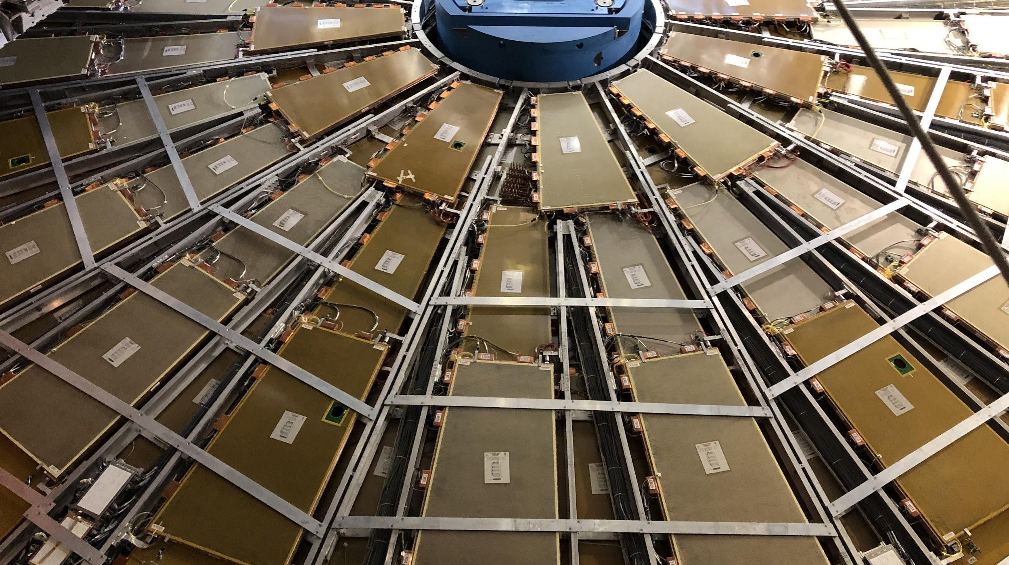


CIS Tech Update
Chicago Weekly Meeting, 3 January 2022
Dawit Belayneh and Katie Hughes

Slide 2
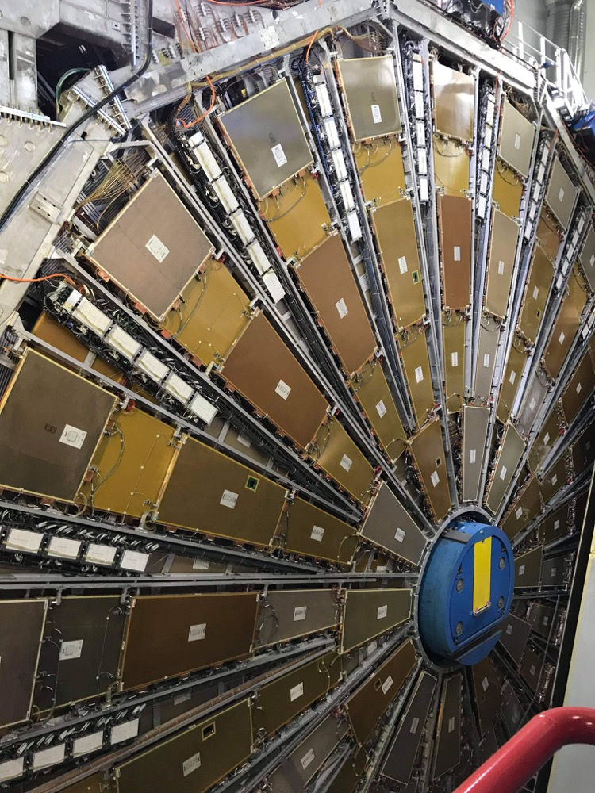
Outline
TileCal Electronics
Charge Injection System (CIS)
CIS and recalibration overview
Summary of Sept., Oct., Nov. CIS updates
Cooling Valve Installations
Motivation
Installation Procedure
Status
LAr Simulation Work
Pictures

Slide 3
TileCal Electronics

Slide 4
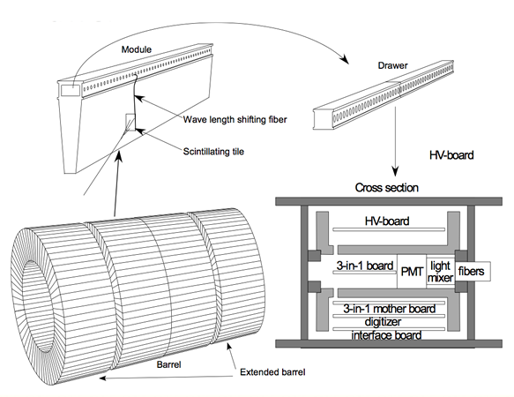
ATLAS Tile Calorimeter
4 Partitions
Long Barrel: LBA, LBC
Extended Barrel: EBA, EBC
64 modules per partition
Scintillating tiles in the modules emit photons when they are excited
Fibers deliver light to PMTs
EBA LBA LBC EBC

Slide 5
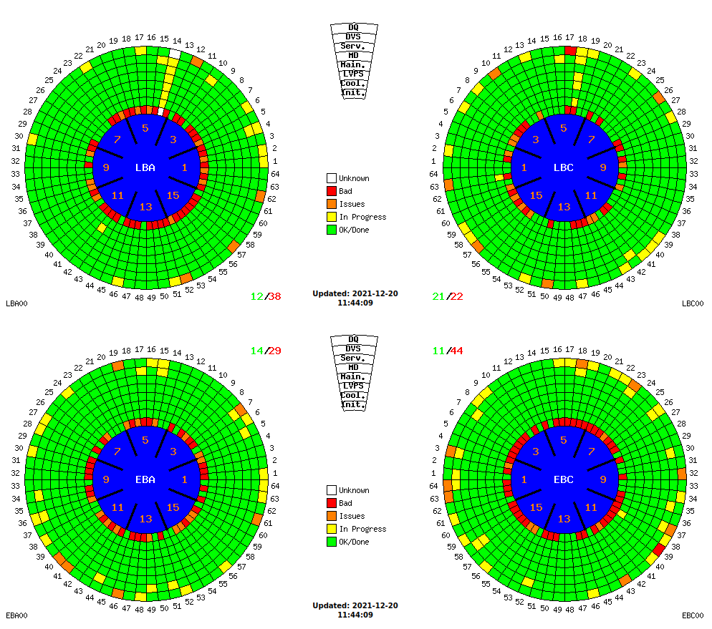
Detector Status

Slide 6
Charge Injection System (CIS)

Slide 7
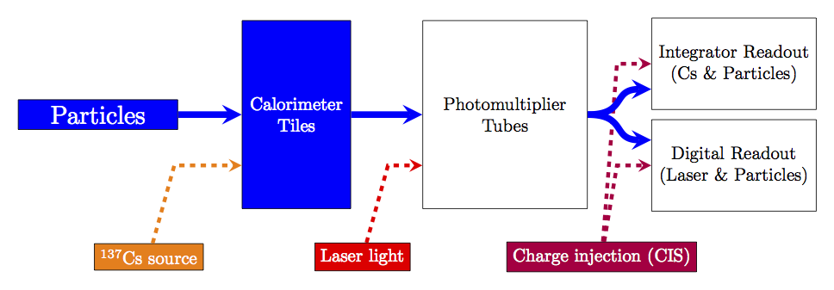
Overview
Calibration system for front-end readout electronics
Simulates physics signals by injecting a known charge and measuring the electronic response
Characterizes each readout channel with a CIS constant

Slide 8
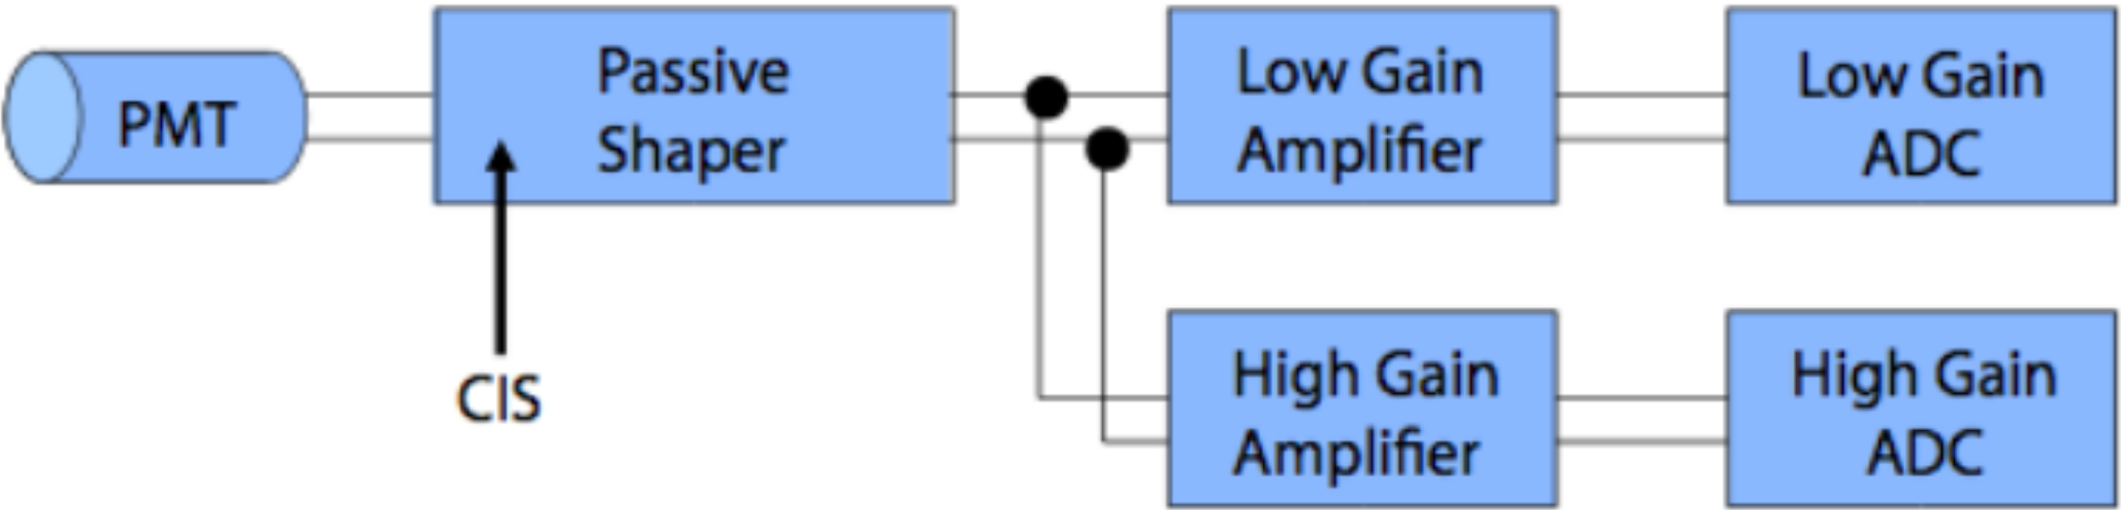
Charge Injection
3-in-1 cards contain 5 pF and 100 pF capacitors
Vary charge of injected pulse
64x gain amplifiers shape and amplify pulse
Pass pulse to analog-to-digital converter (ADC)

Slide 9
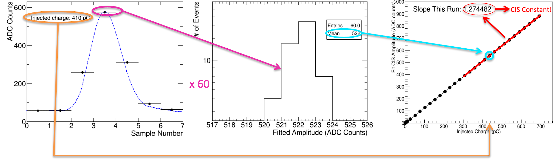
Calibration Constants
60 injections of a set charge sampled 7 times
15 steps varying phase between injection and sampling
4 capacitor discharges each
Mean amplitude of pulse measured for different charges
Amplitude (ADC counts) vs charge (pC) fit gives CIS constant
For each of ~19,700 channels!

Slide 10
CIS Constant Recalibration
CIS runs taken twice per week during LS2
Goal: verify maintenance and identify DQ (data quality) problems
TileCal Unified Calibration Software (TUCS) used to track detector performance and diagnose problematic channels
Calculate new constants within given interval of validity
Exclude outliers and stable outliers, identify DQ flags
Update databases approximately monthly

Slide 11
Procedure
Run a general TUCS script that generates plots of CIS constants vs time
Time range: last CIS update to present
Go through plots by hand to check validity of constants
Good CIS plots are very stable over time and close to the detector mean
Possible changes that need to be made manually:
Recalibration (run over a shorter time range)
Flag update (add BadCIS / remove BadCIS)
Exclude problematic runs for certain partition+gain combinations (bad timing, bad amplitude/charge ratio)
Add manual changes and upload constants to database

Slide 12
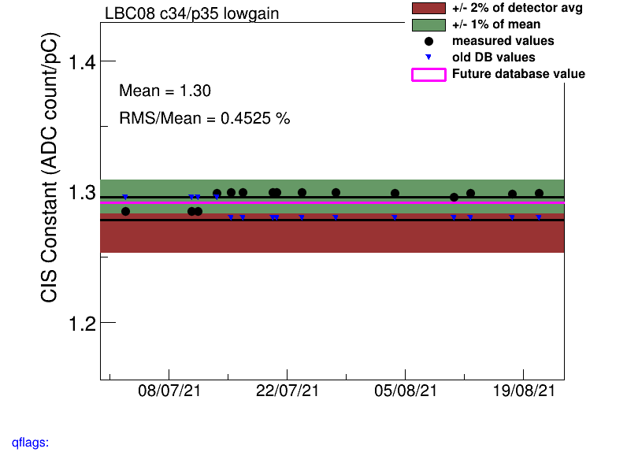
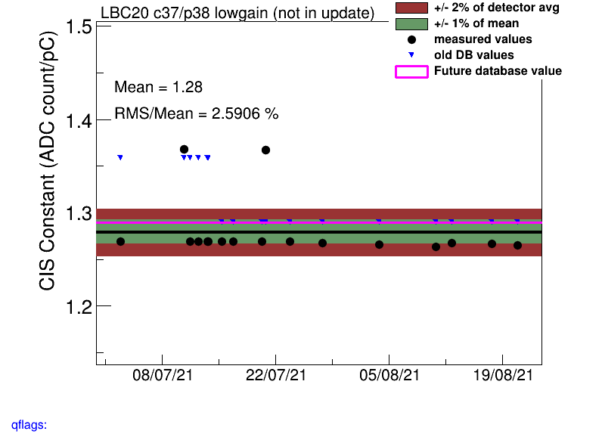
Recalibration
Often there is a constant shift in the CIS constant at some date, or 1-2 outlier points that skew the mean
Solution: run over a shorter time period, so long as the newer value appears stable

Slide 13
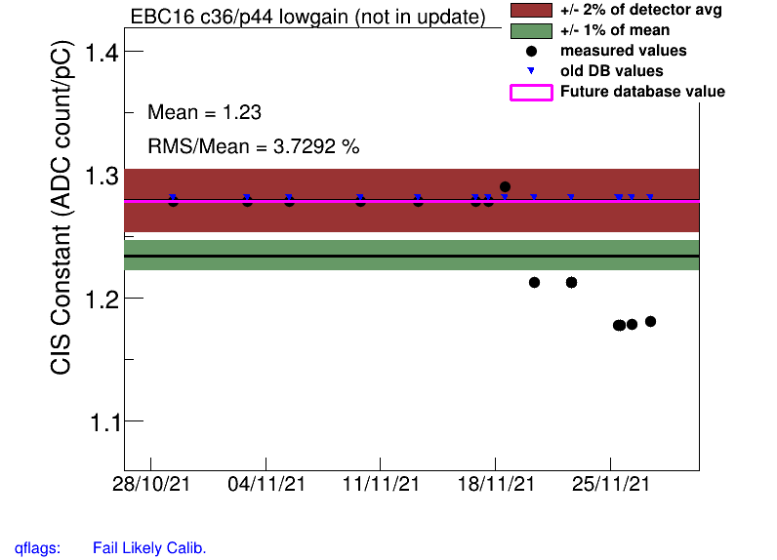
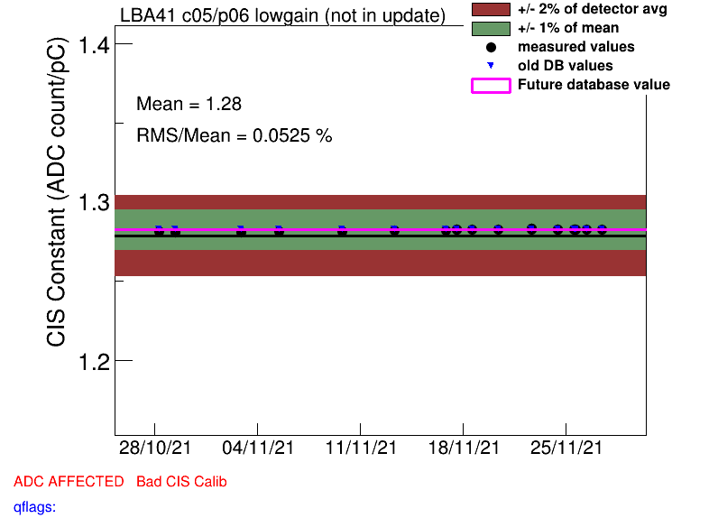
Flag Update
Sometimes channels are incorrectly flagged as BadCIS, or vice versa
Notes:
Add some particularly dramatic examples!!!

Slide 14
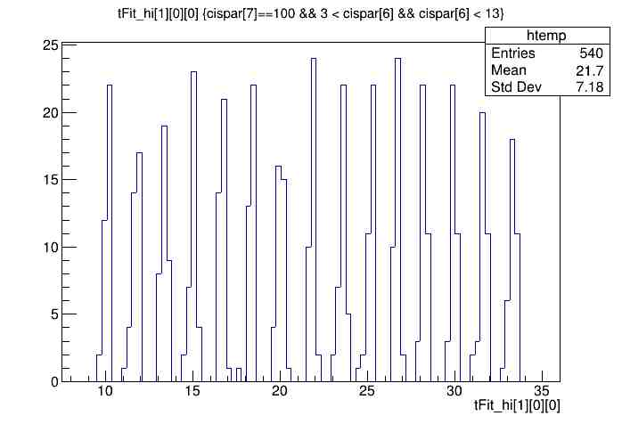
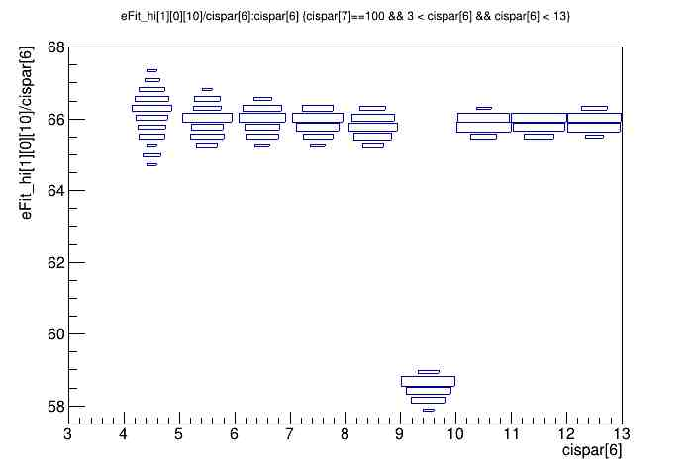
Timing and Amplitude/Charge Ratio
Timing should be consistent across all valid runs, typically in the range of (-15, 10) ns. Here, it’s shifted by +25 ns.
Amplitude/charge ratio for this CIS run in LBC highgain is unstable, so we should not use it.
Notes:
Add examples!!!

Slide 15
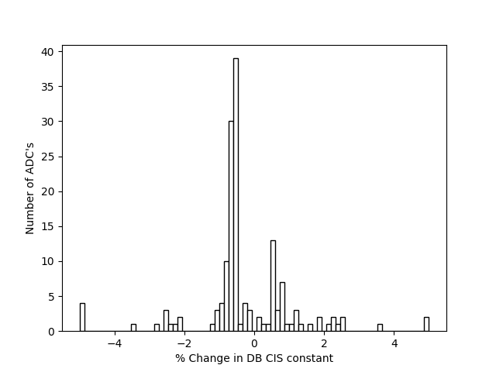
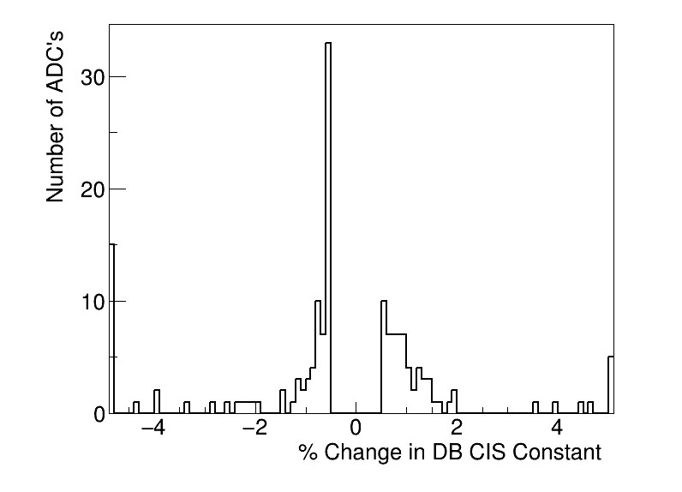
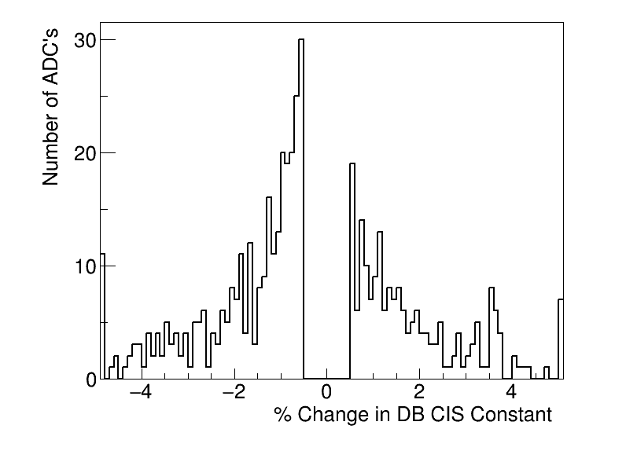
CIS Update Summaries
September
CIS runs from Aug 23 - Sept 24
153 channels updated
6 with >5% change
October
CIS runs from Oct 12 - Oct 25
159 channels updated
20 with >5% change
November
CIS runs from Oct 28 - Nov 27
505 channels updated
15 with >5% change

Slide 16
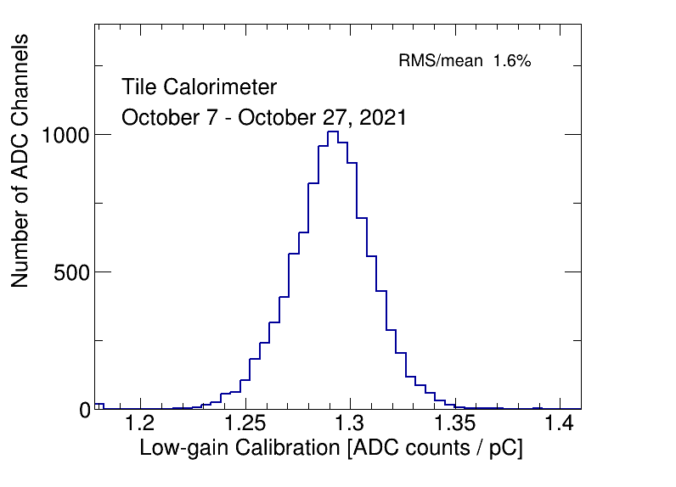
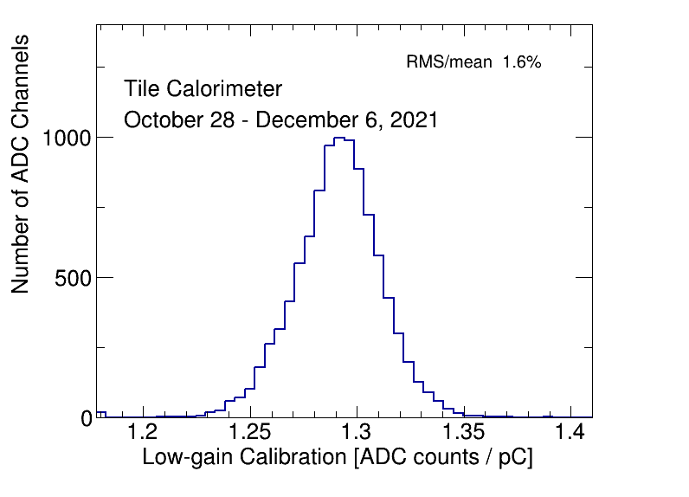
CIS Constant Distributions (Low Gain)
Should be Gaussian and centered around 1.29 ADC counts/pC

Slide 17
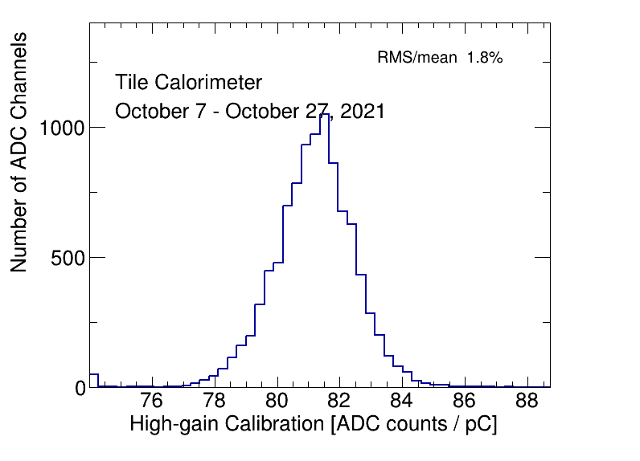
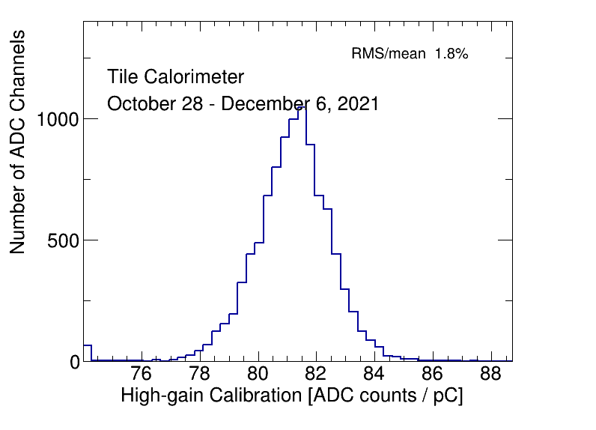
CIS Constant Distributions (High Gain)
Should be Gaussian and centered around 81 ADC counts/pC

Slide 18
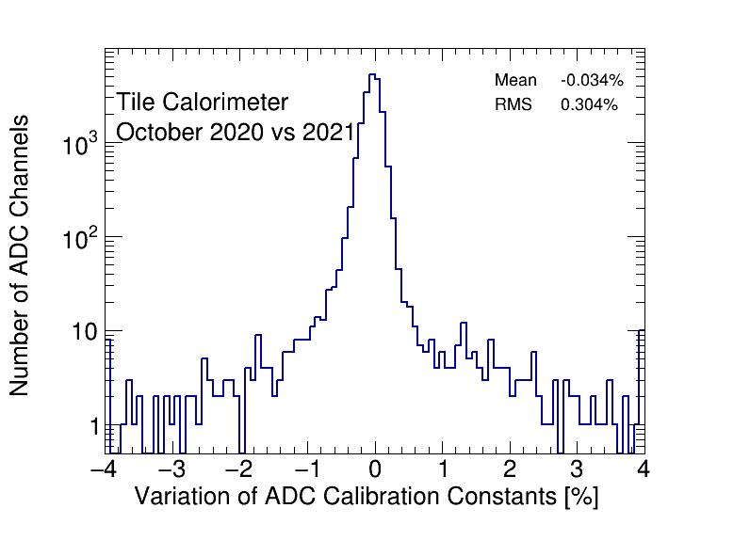
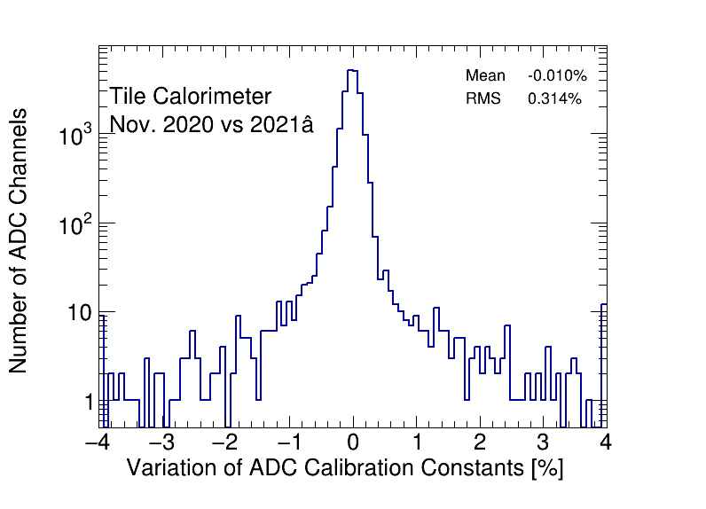
CIS Constant Stability

Slide 19
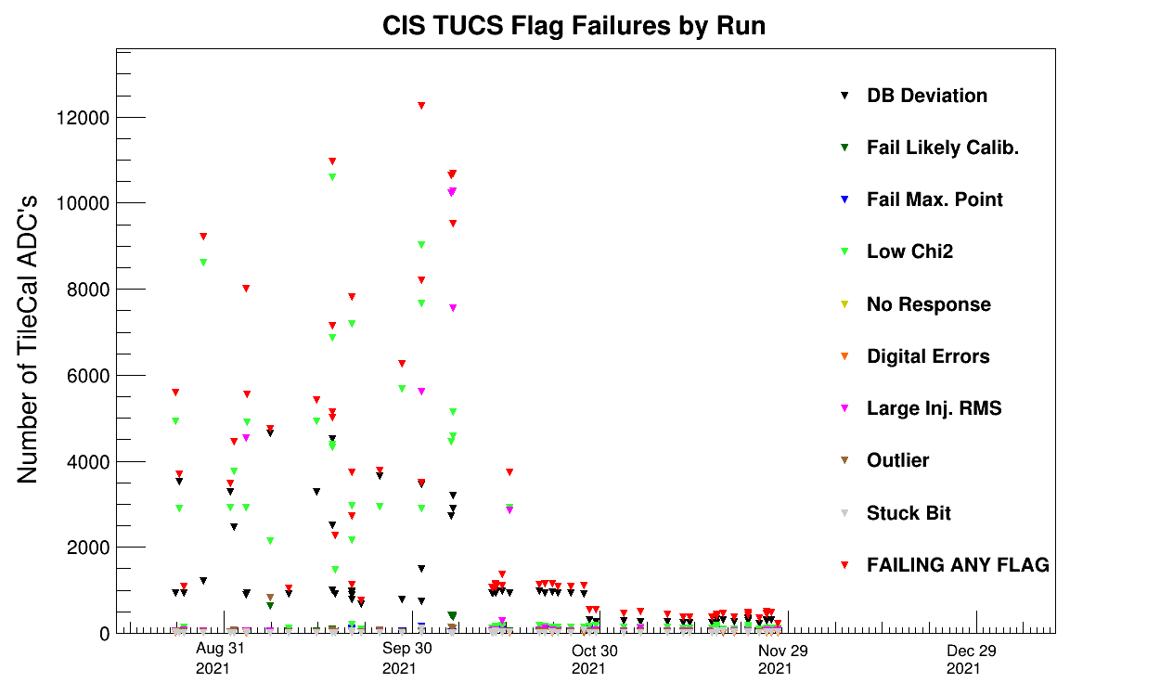
TUCS Quality Flags
We used advanced run selection for Sept. CIS update

Slide 20
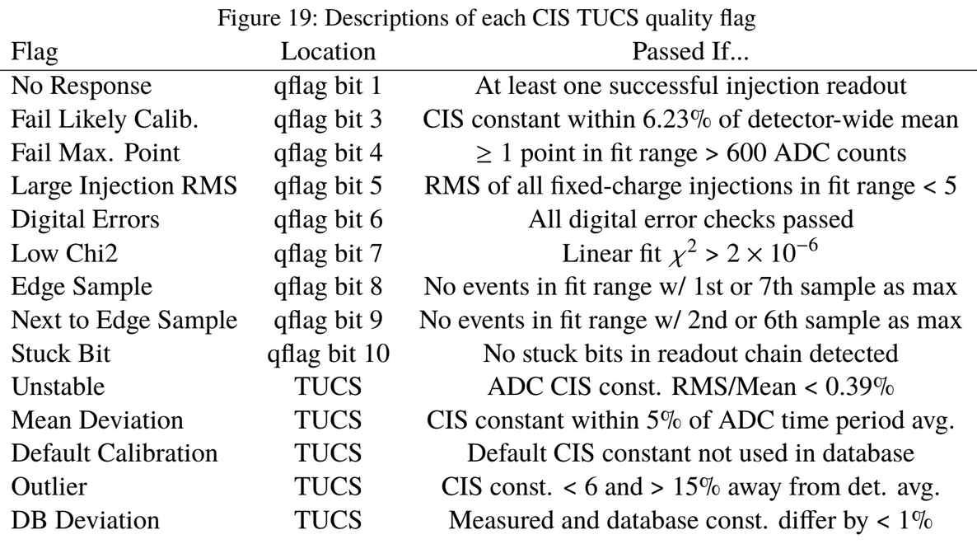
TUCS Quality Flags

Slide 21
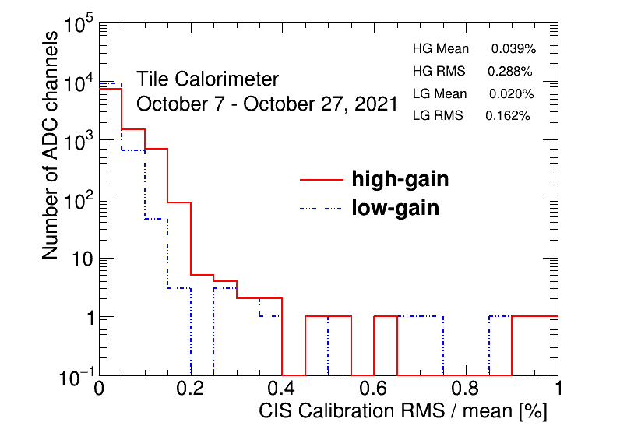
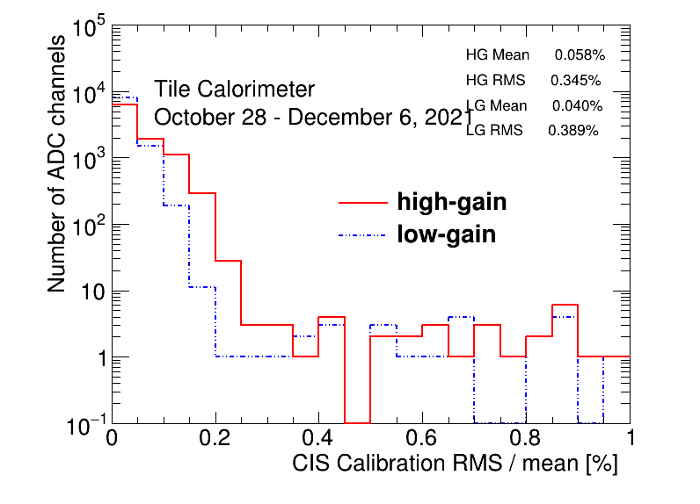
CIS Constant RMS/Mean

Slide 22
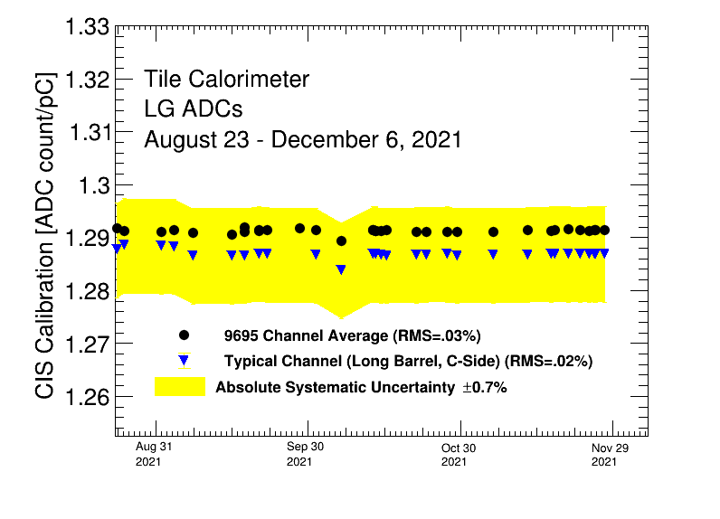
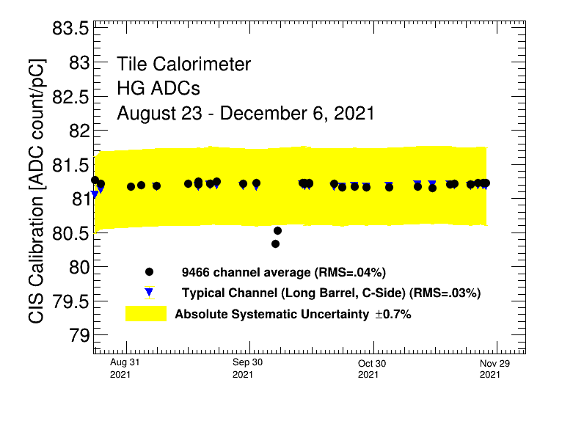
Detector Stability
Runs in early October were not used to calculate CIS constants

Slide 23
Next Steps
Starting CIS update for December (?)
Continue figuring out ways to streamline the update process
Look into how the TUCS script assigns/removes bad CIS
Create a new TUCS script / wrapper that allows us to specify different valid runs for different modules in one command
Can sort of accomplish this with a bash script, but we think there is a more concise way to do it
Would allow us to produce accurate cumulative plot

Slide 24
Cooling Valve Installations

Slide 25
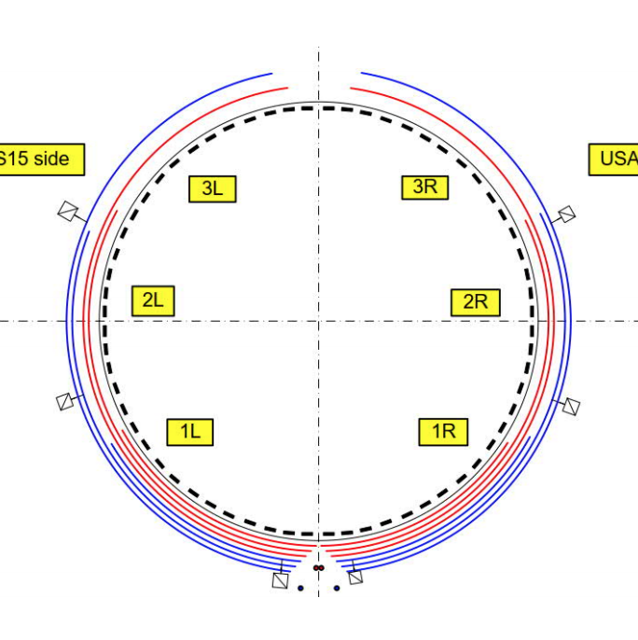
Motivation
Currently, a single cooling loop passes through 8-12 drawers
6 loops per partition
A leak in one drawer means all other drawers in the loop must be shut down to fix it
Valves will now isolate leaks to a single drawer
Cooling Loop Distribution

Slide 26
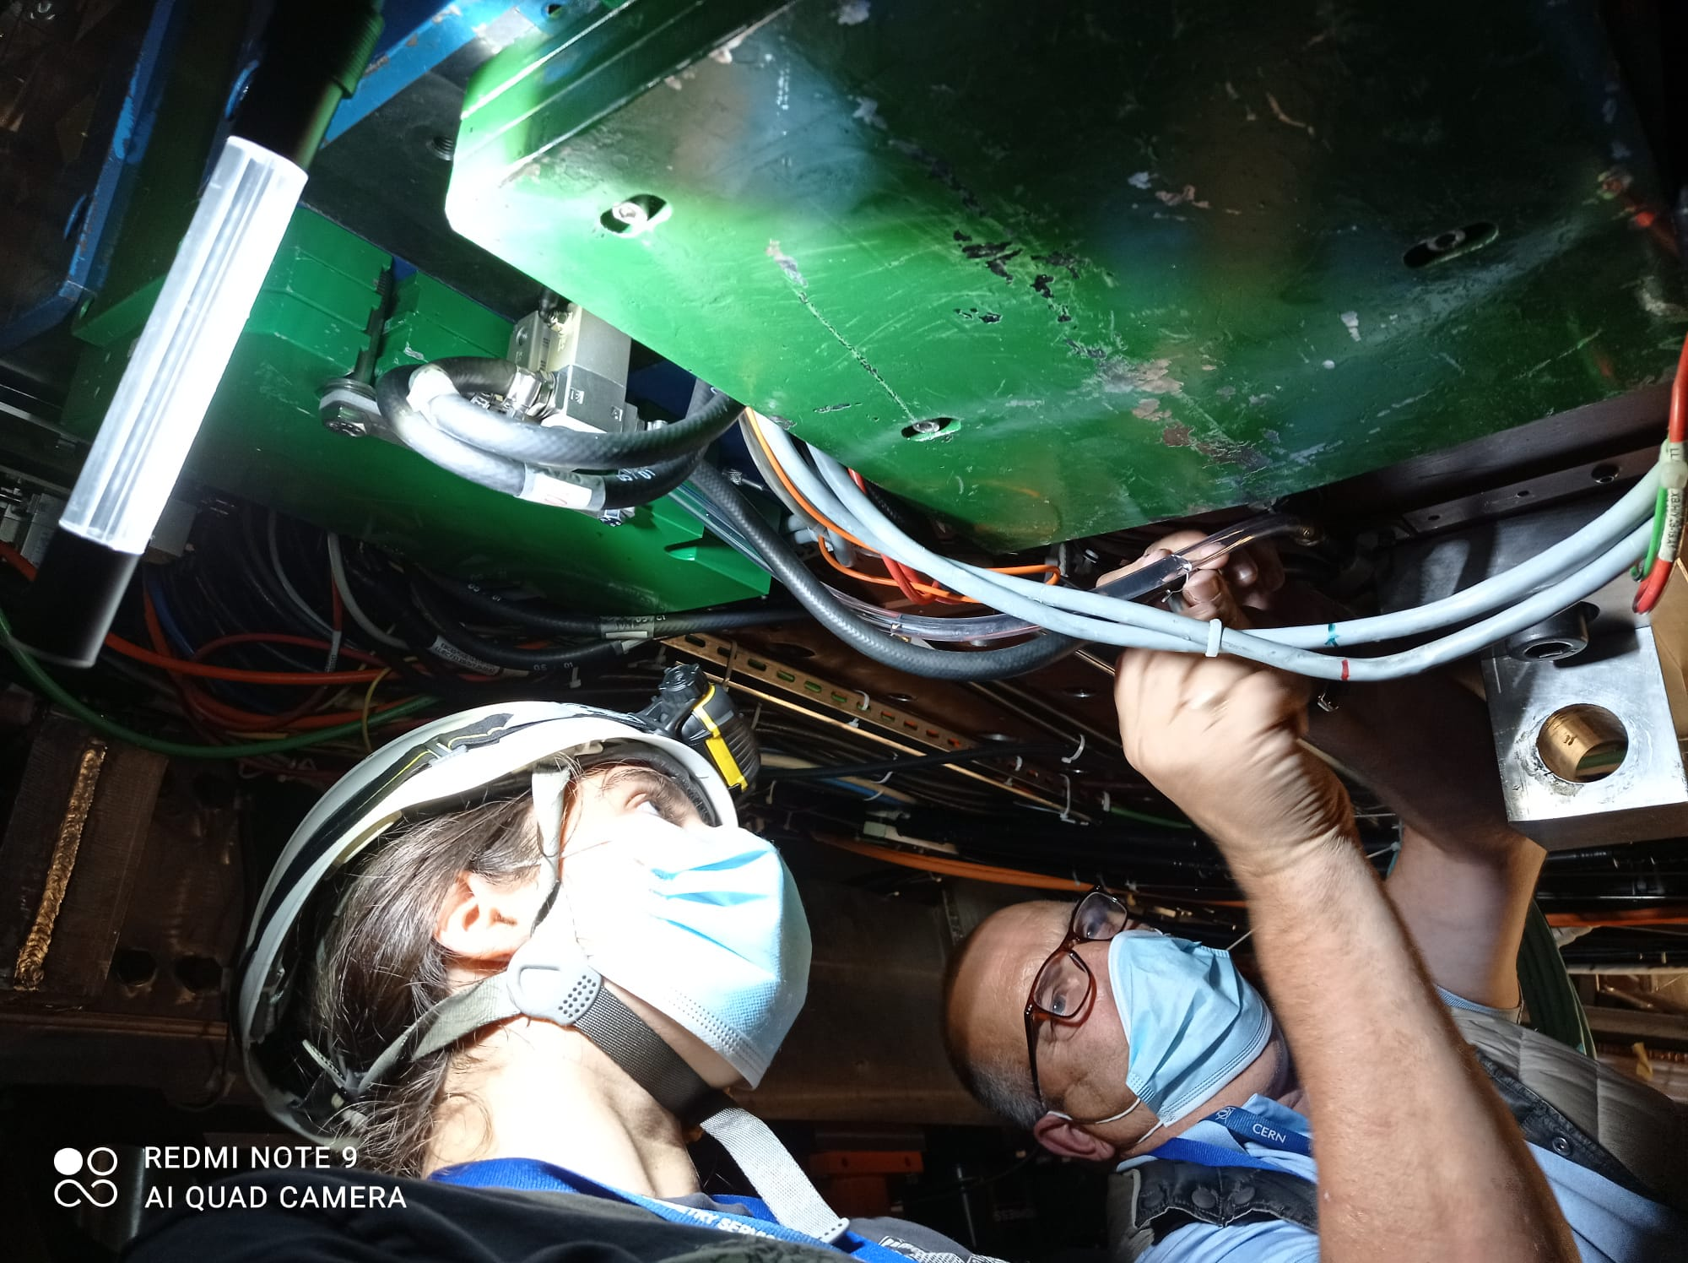
Procedure
Build and test valves
Mount brackets with valves on drawers
Stop cooling loops, connect hoses to valves, restart loops and check for leaks
Connect air hoses and verify they actually shut off the valves (commissioning)

Slide 27
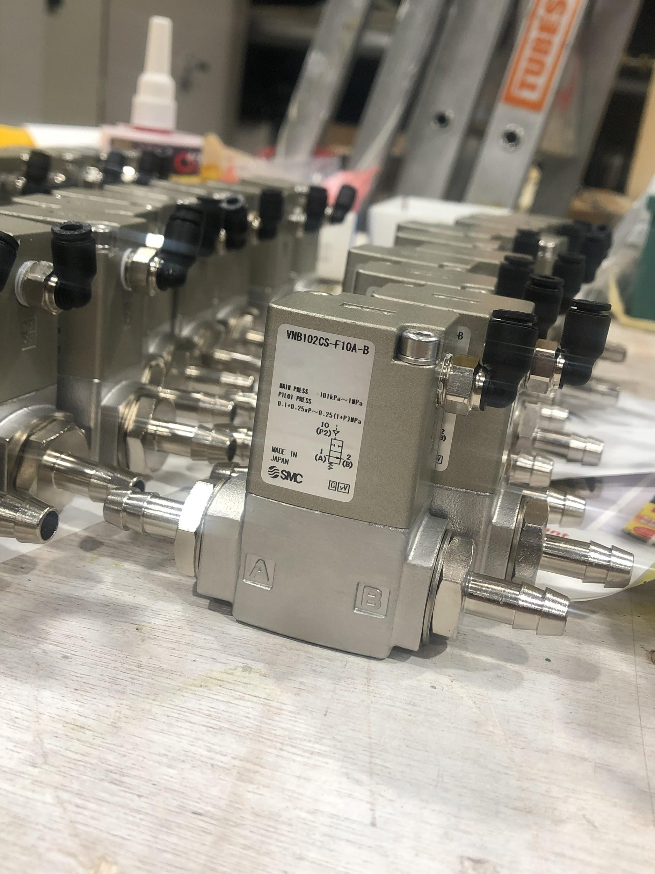
Building and Testing Valves
Add non-magnetic and radiation-resistant parts
Attach nozzles with adhesive, let valves sit for >24 hours so that seal has time to dry
Test seal quality under pressure. If valves pass, they are ready to be installed
Since the last report we assembled over 120 with 0 failures

Slide 28
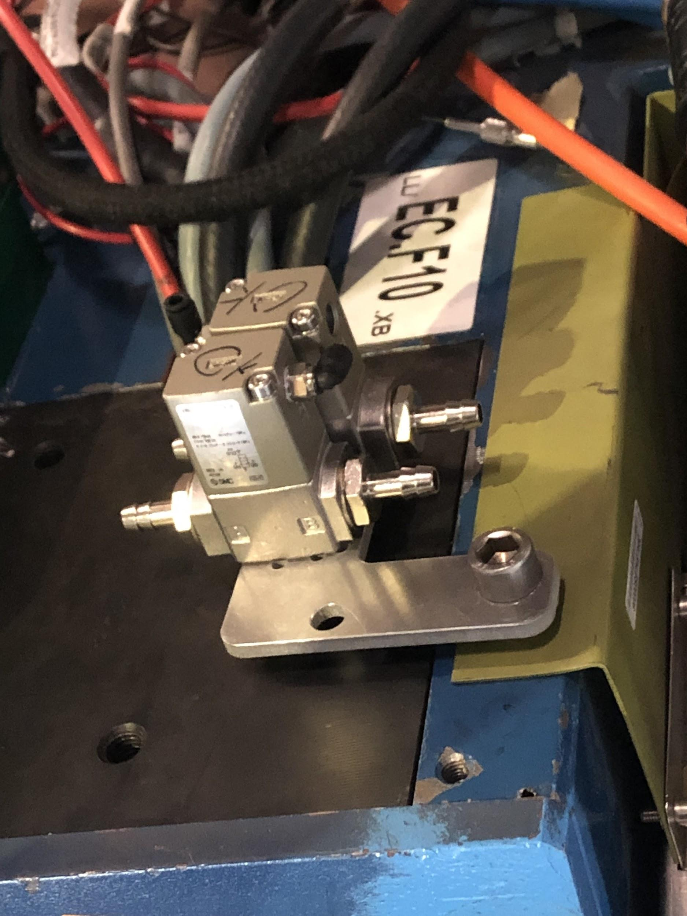
Mounting Valves
Have a variety of different shapes of mounting plates
Orientation is critical!
Hoses must be able to reach valve nozzles without bending too much
Valve nozzles must not be too close to walls/other wires
Ideally plates should be secured with two bolts, but sometimes that is not possible

Slide 29
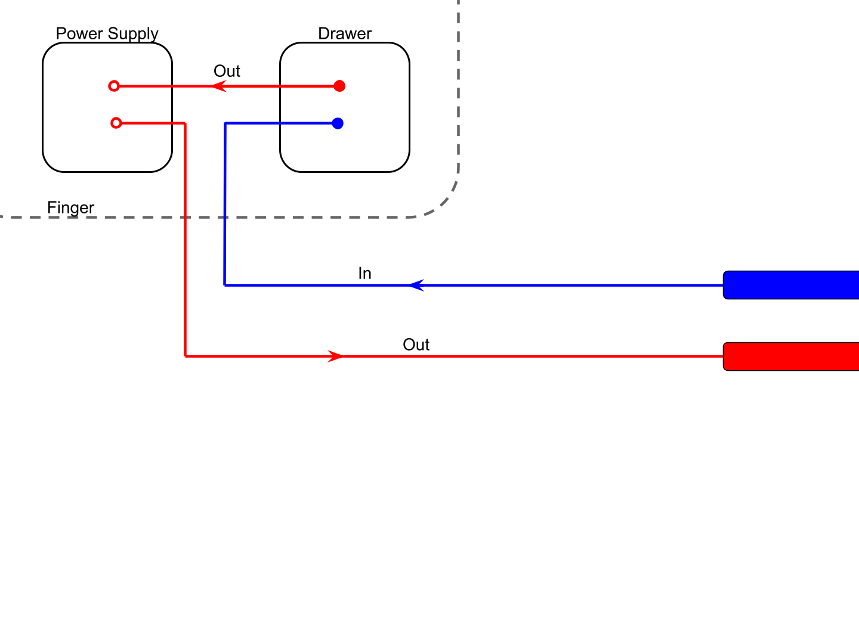
Initial Hose Connection
Pipes

Slide 30
Method
Disconnect hoses here -- don’t touch the hoses inside the drawer. Cut new hoses and fit their end to the in/out pipes.

Slide 31
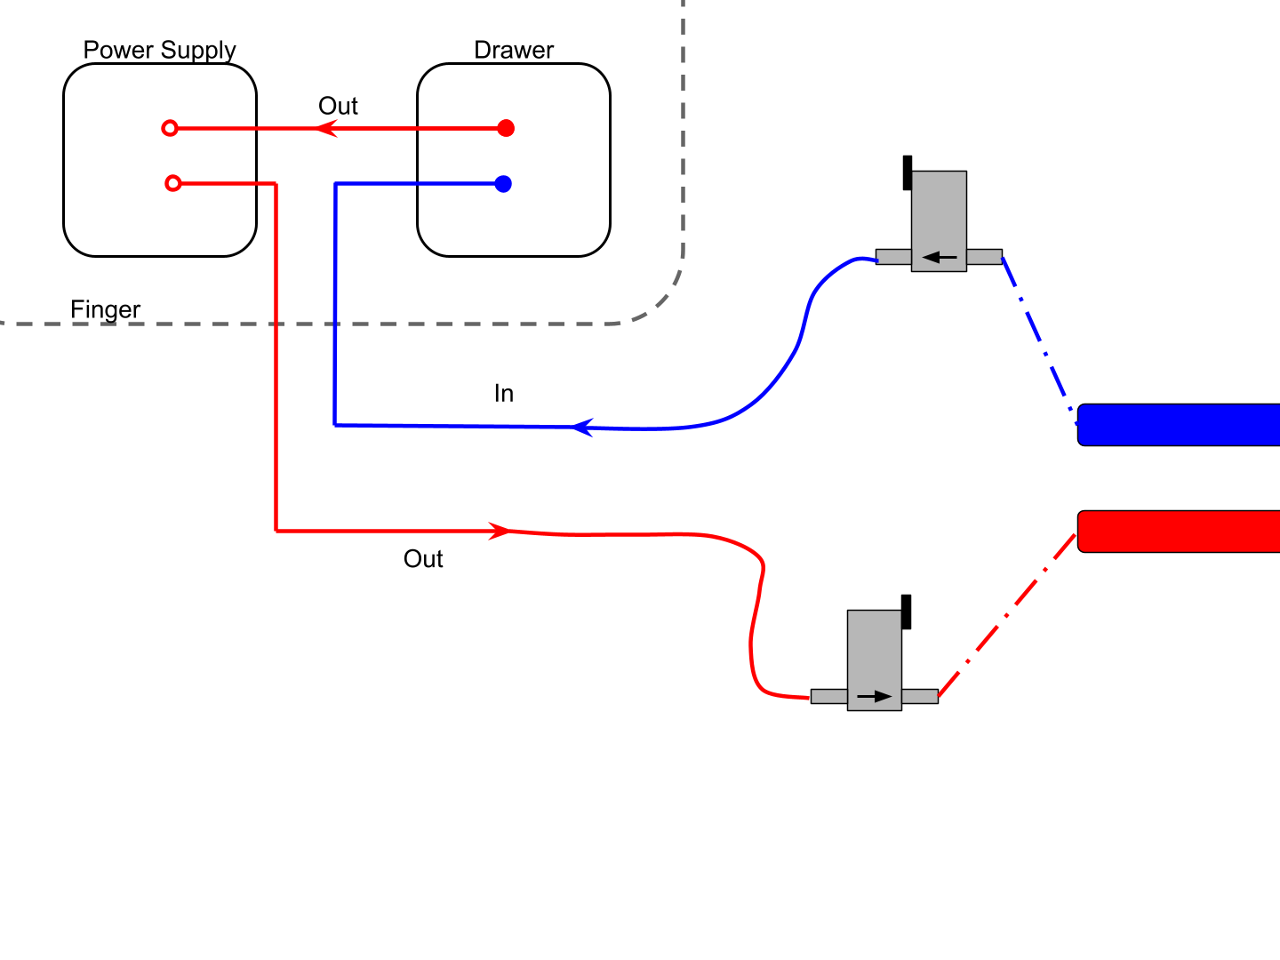
Method
This is a much quicker method as we don’t have to open the drawers! However, sometimes it can be awkward to reach the in/out pipes as often they are far away from the scaffolding.

Slide 32
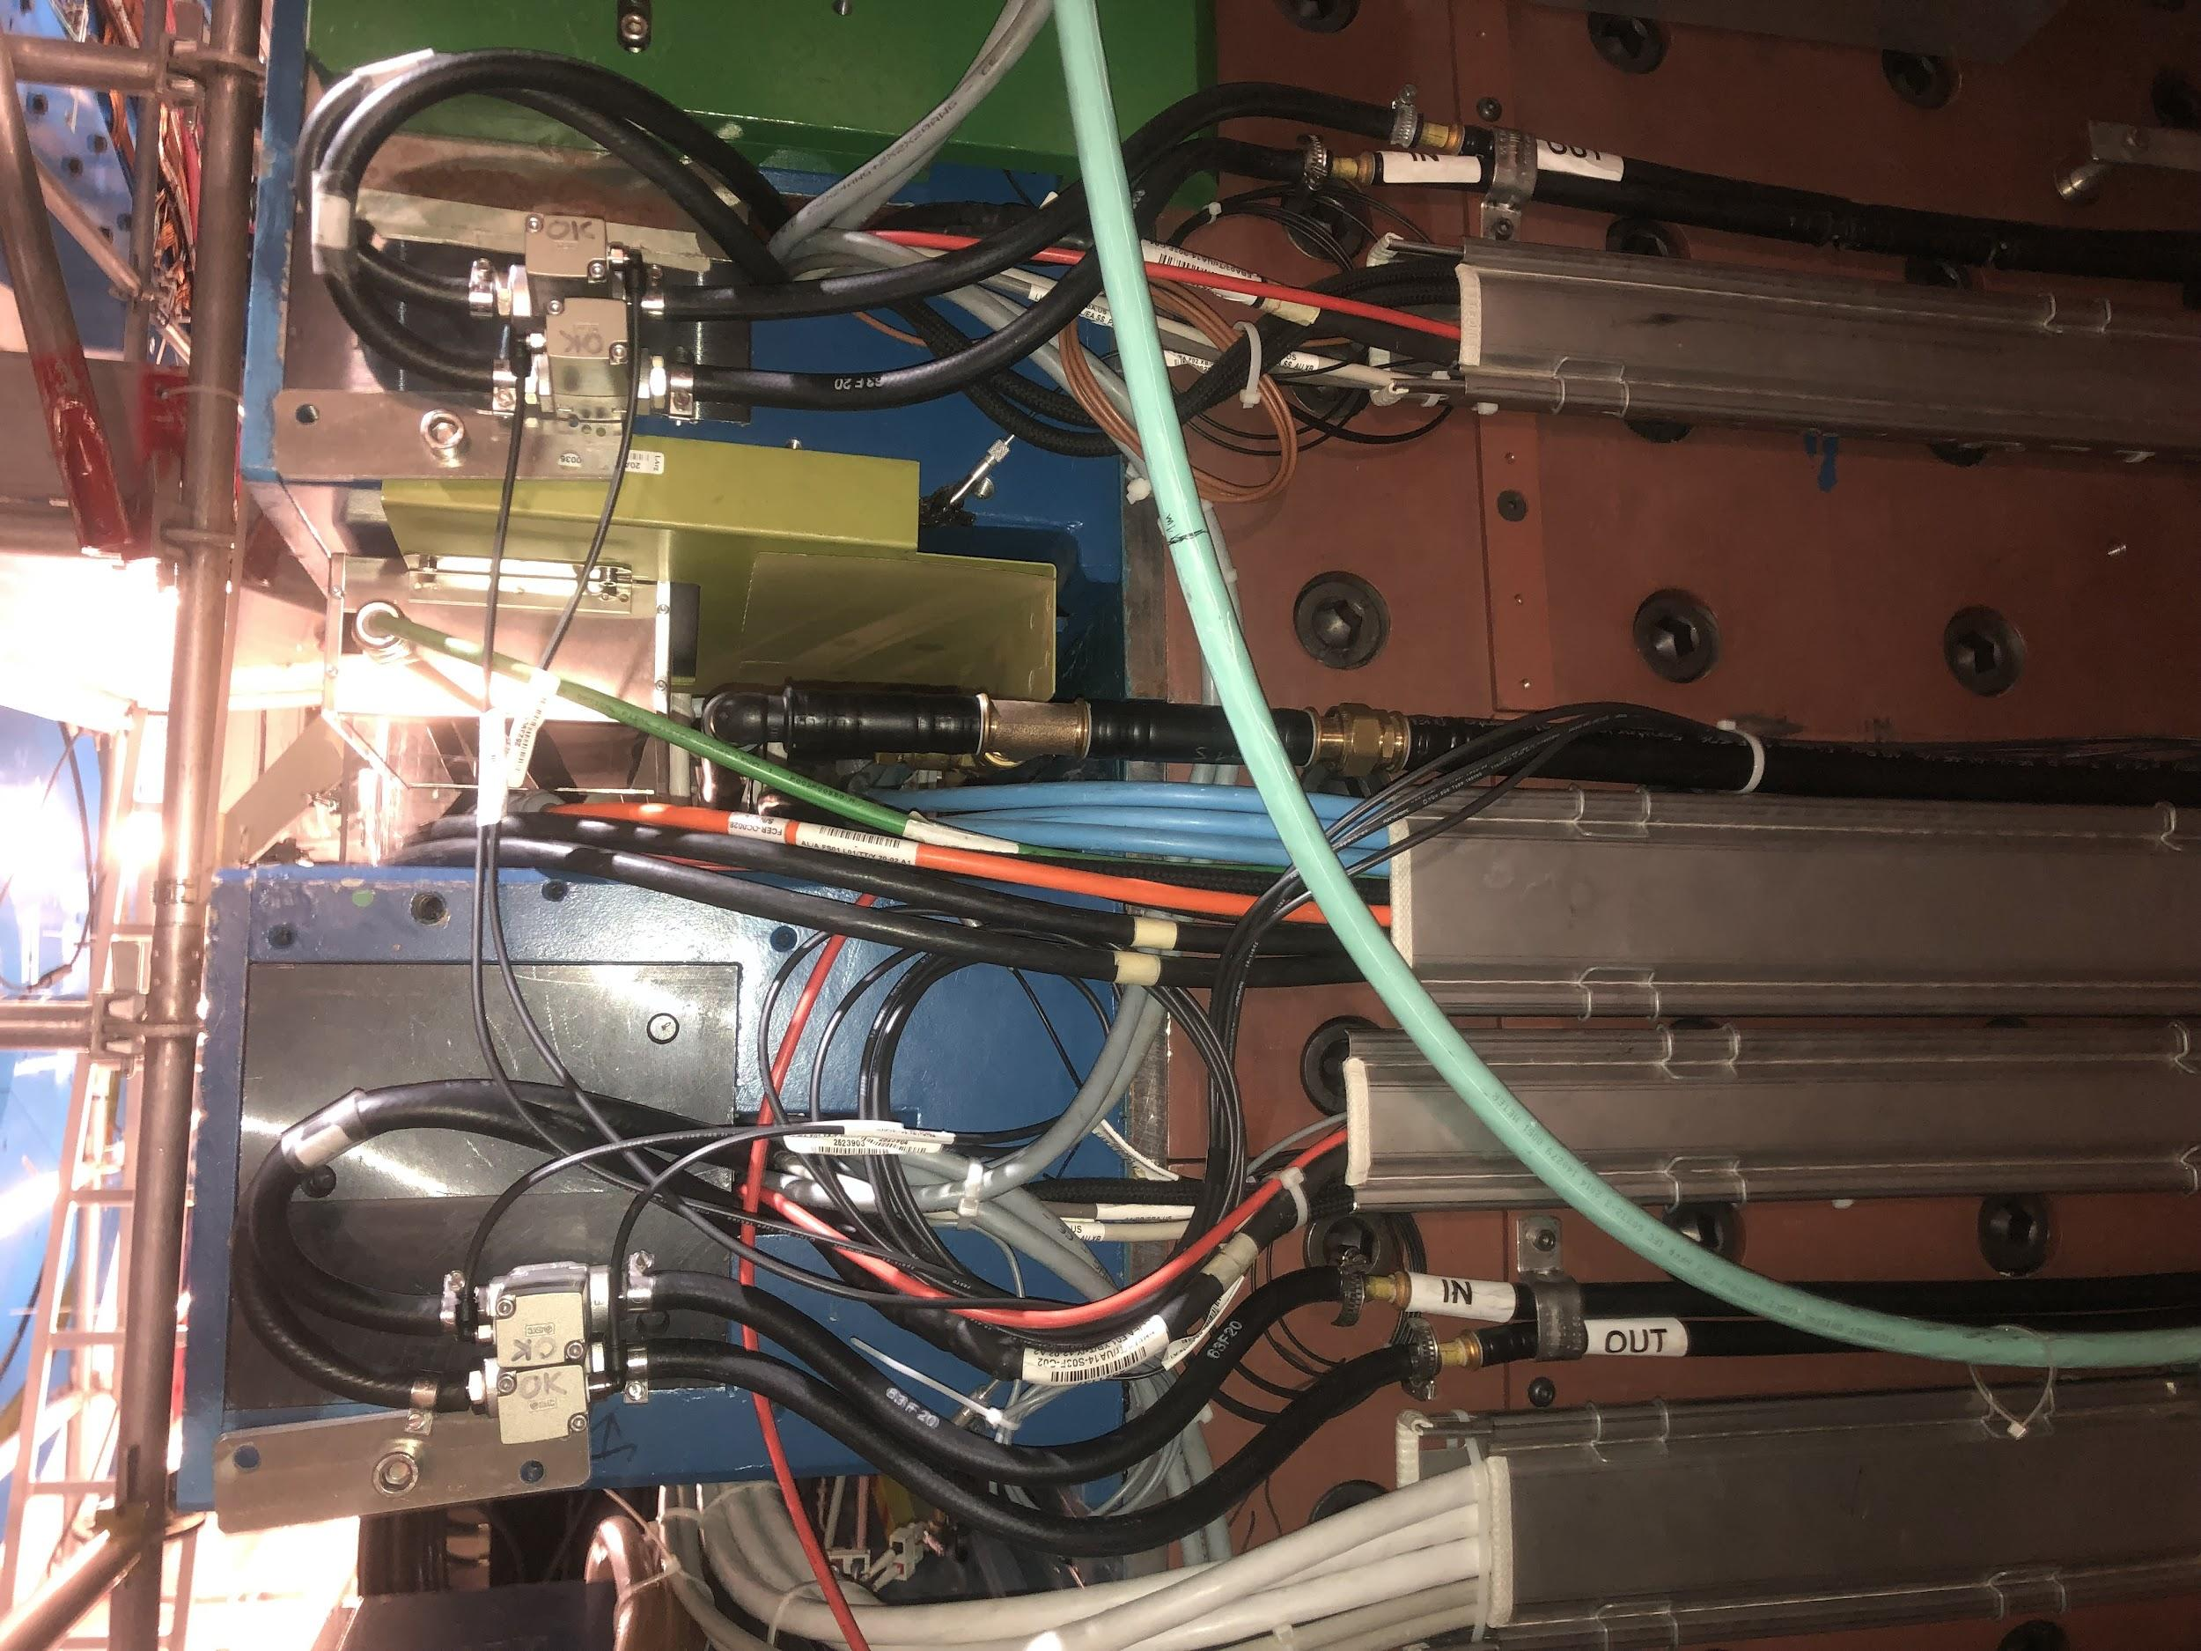
Examples

Slide 33
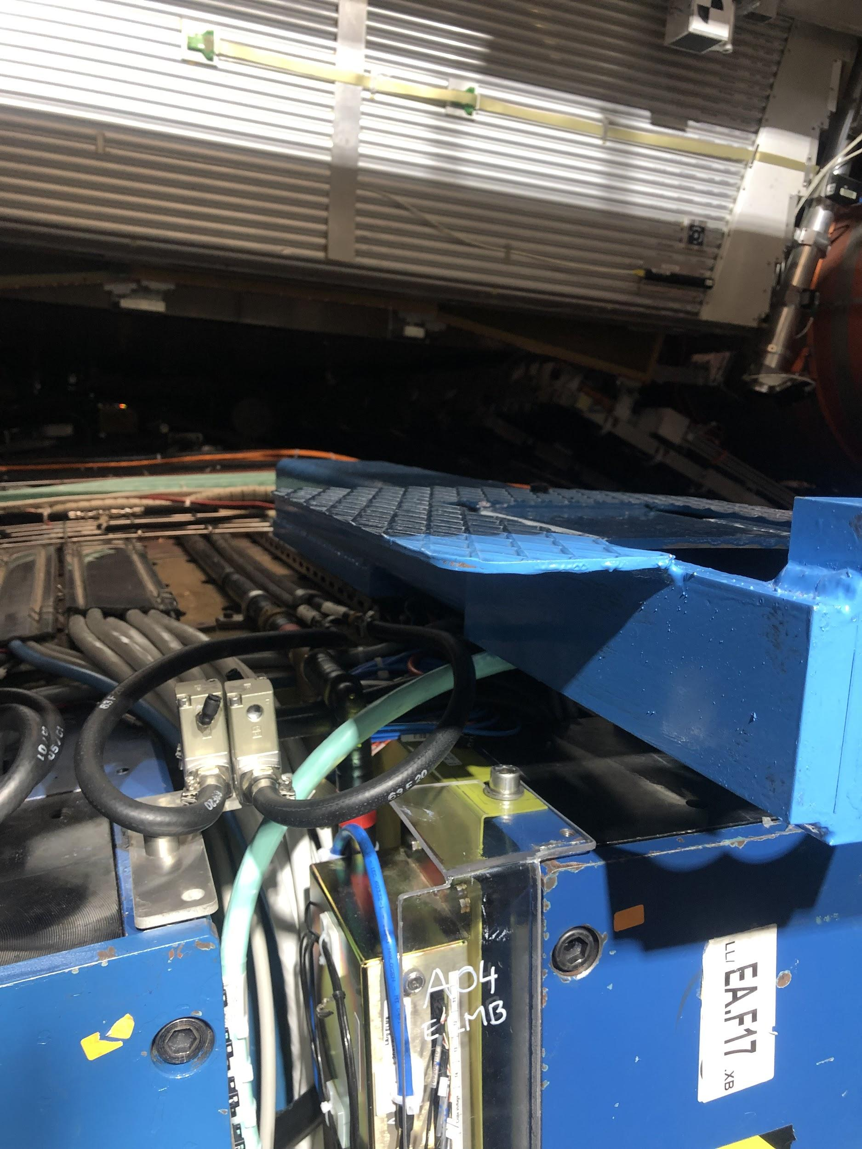
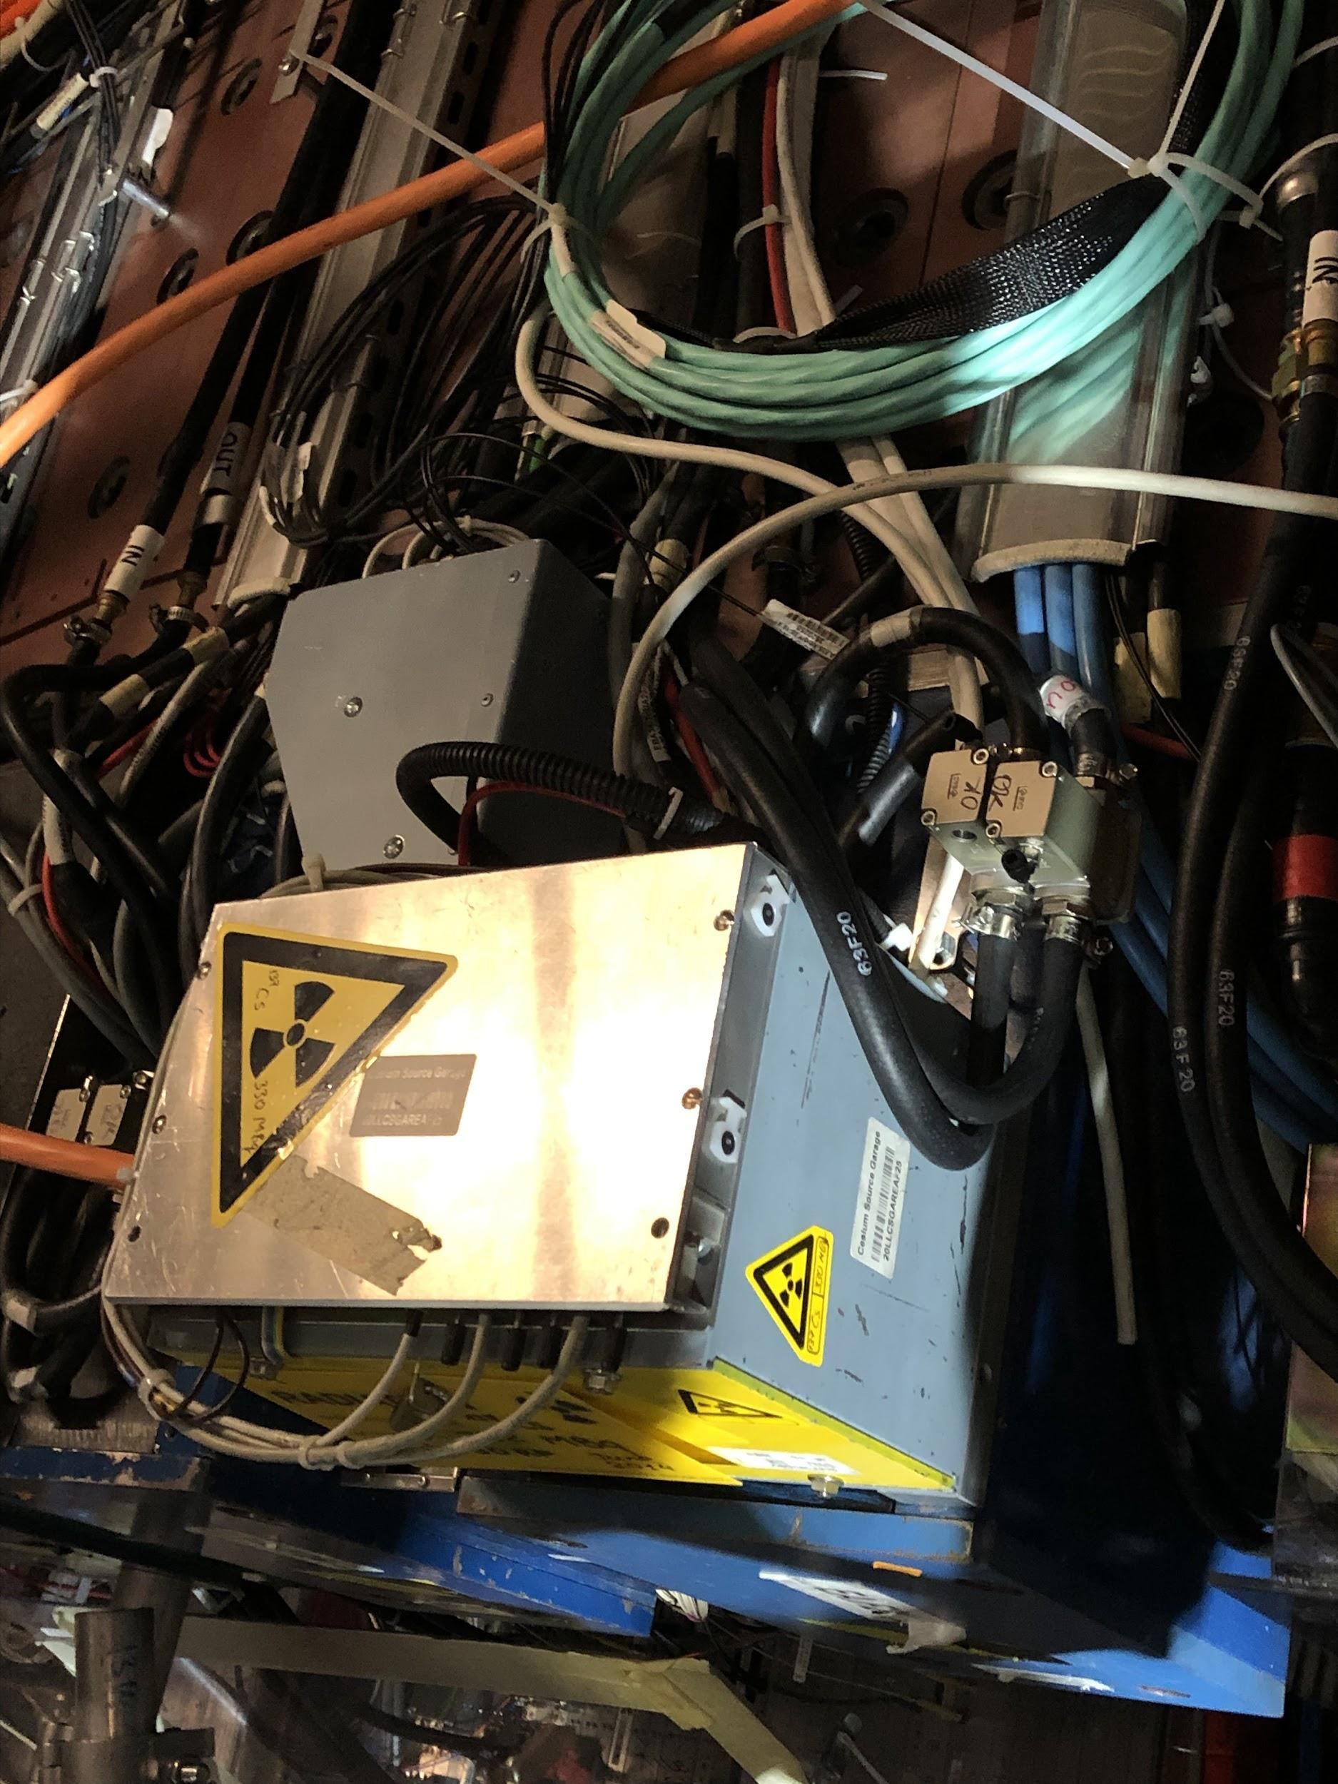
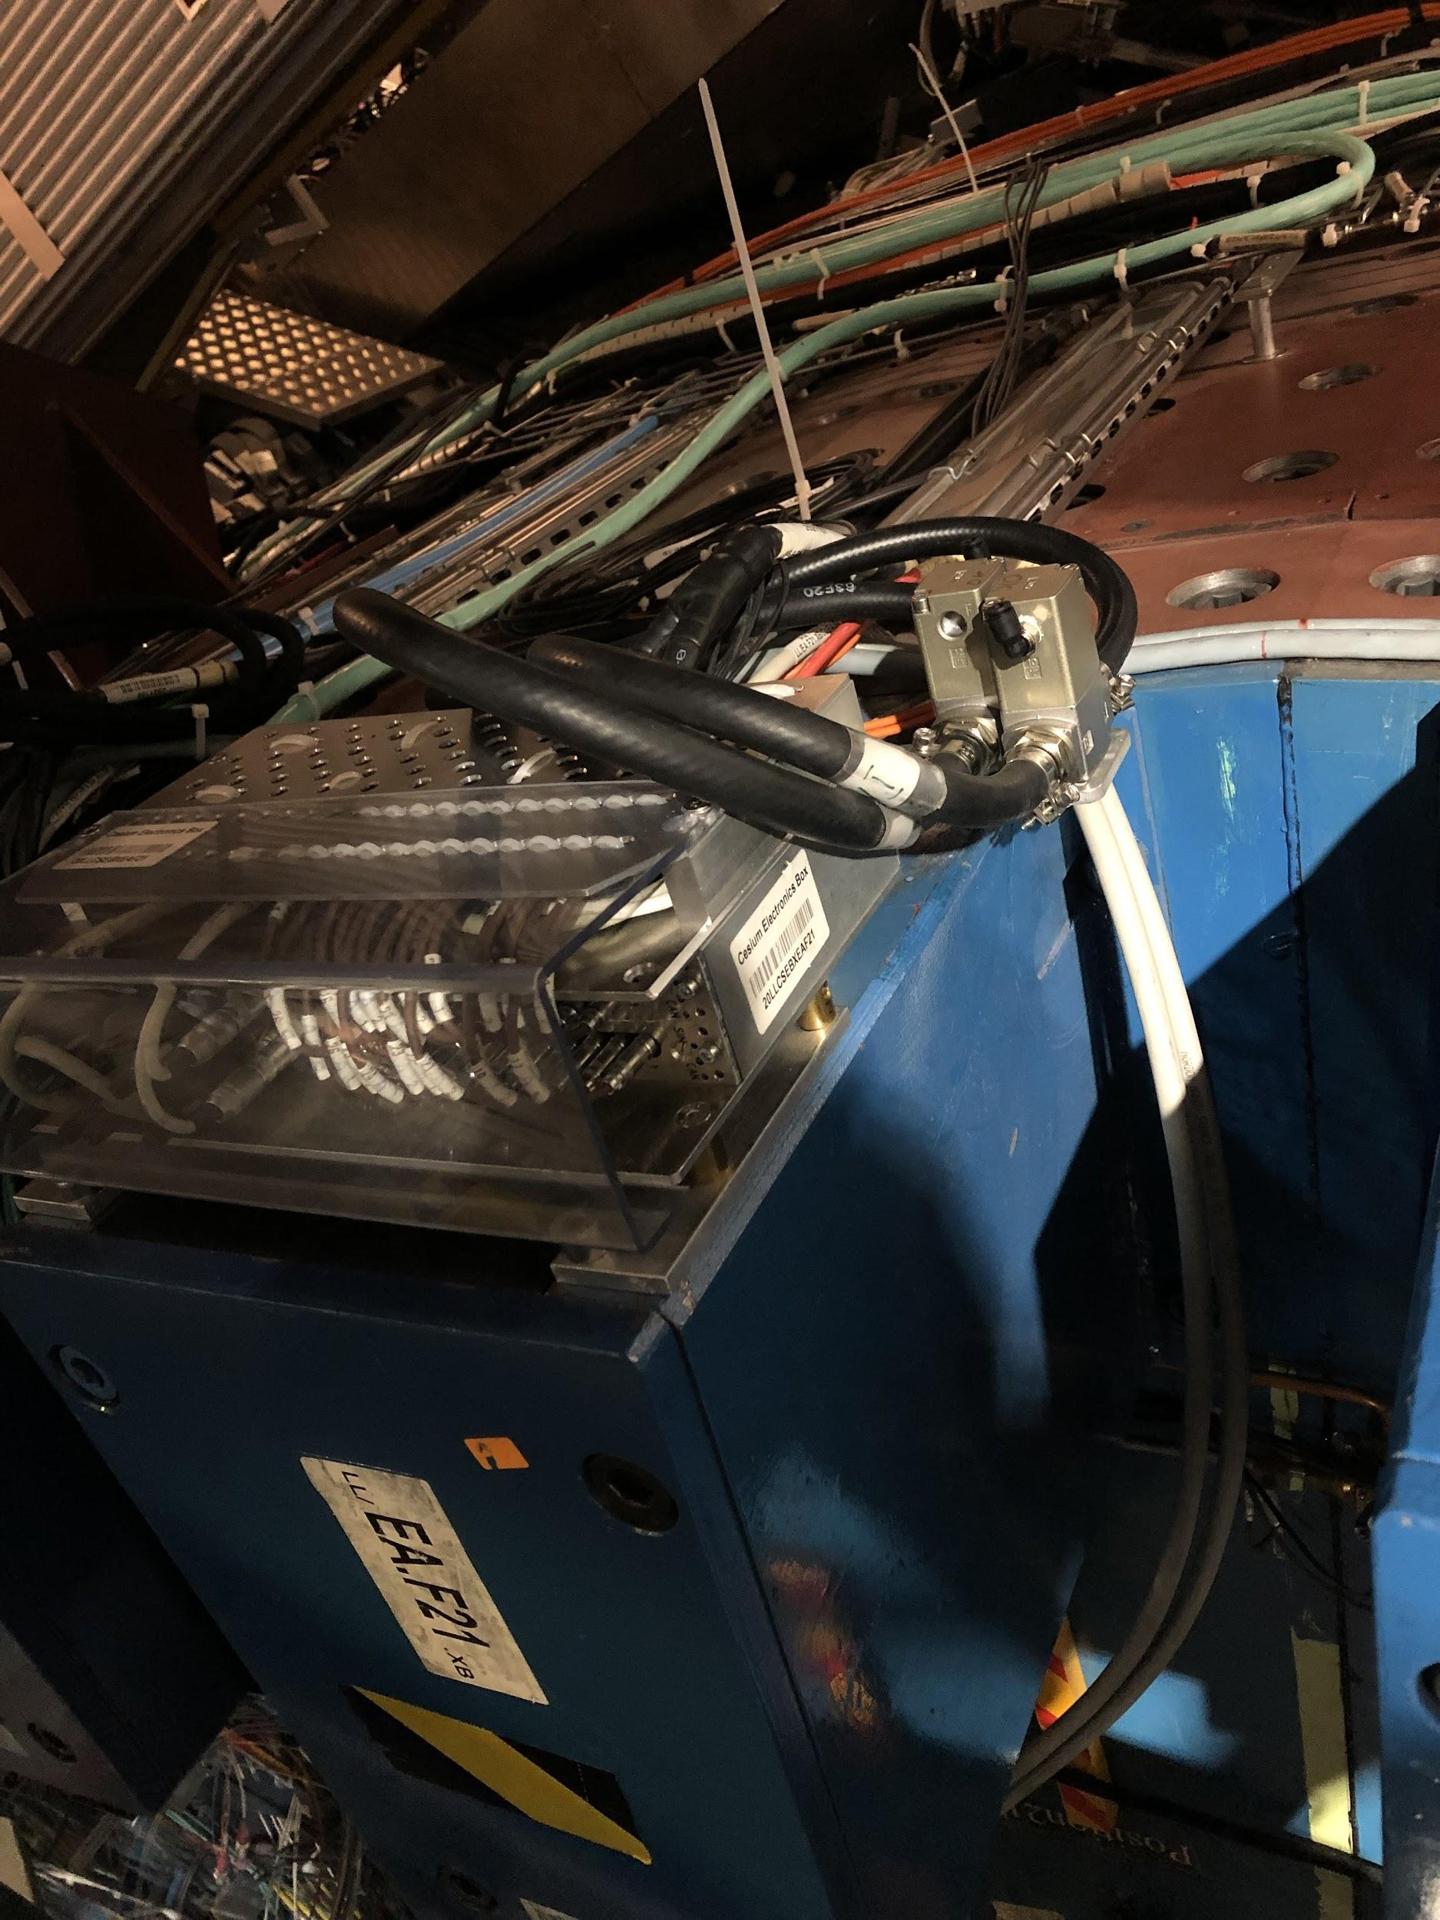
Examples (more complicated)
Middle Beam
Cs source box
Cs electronics box

Slide 34
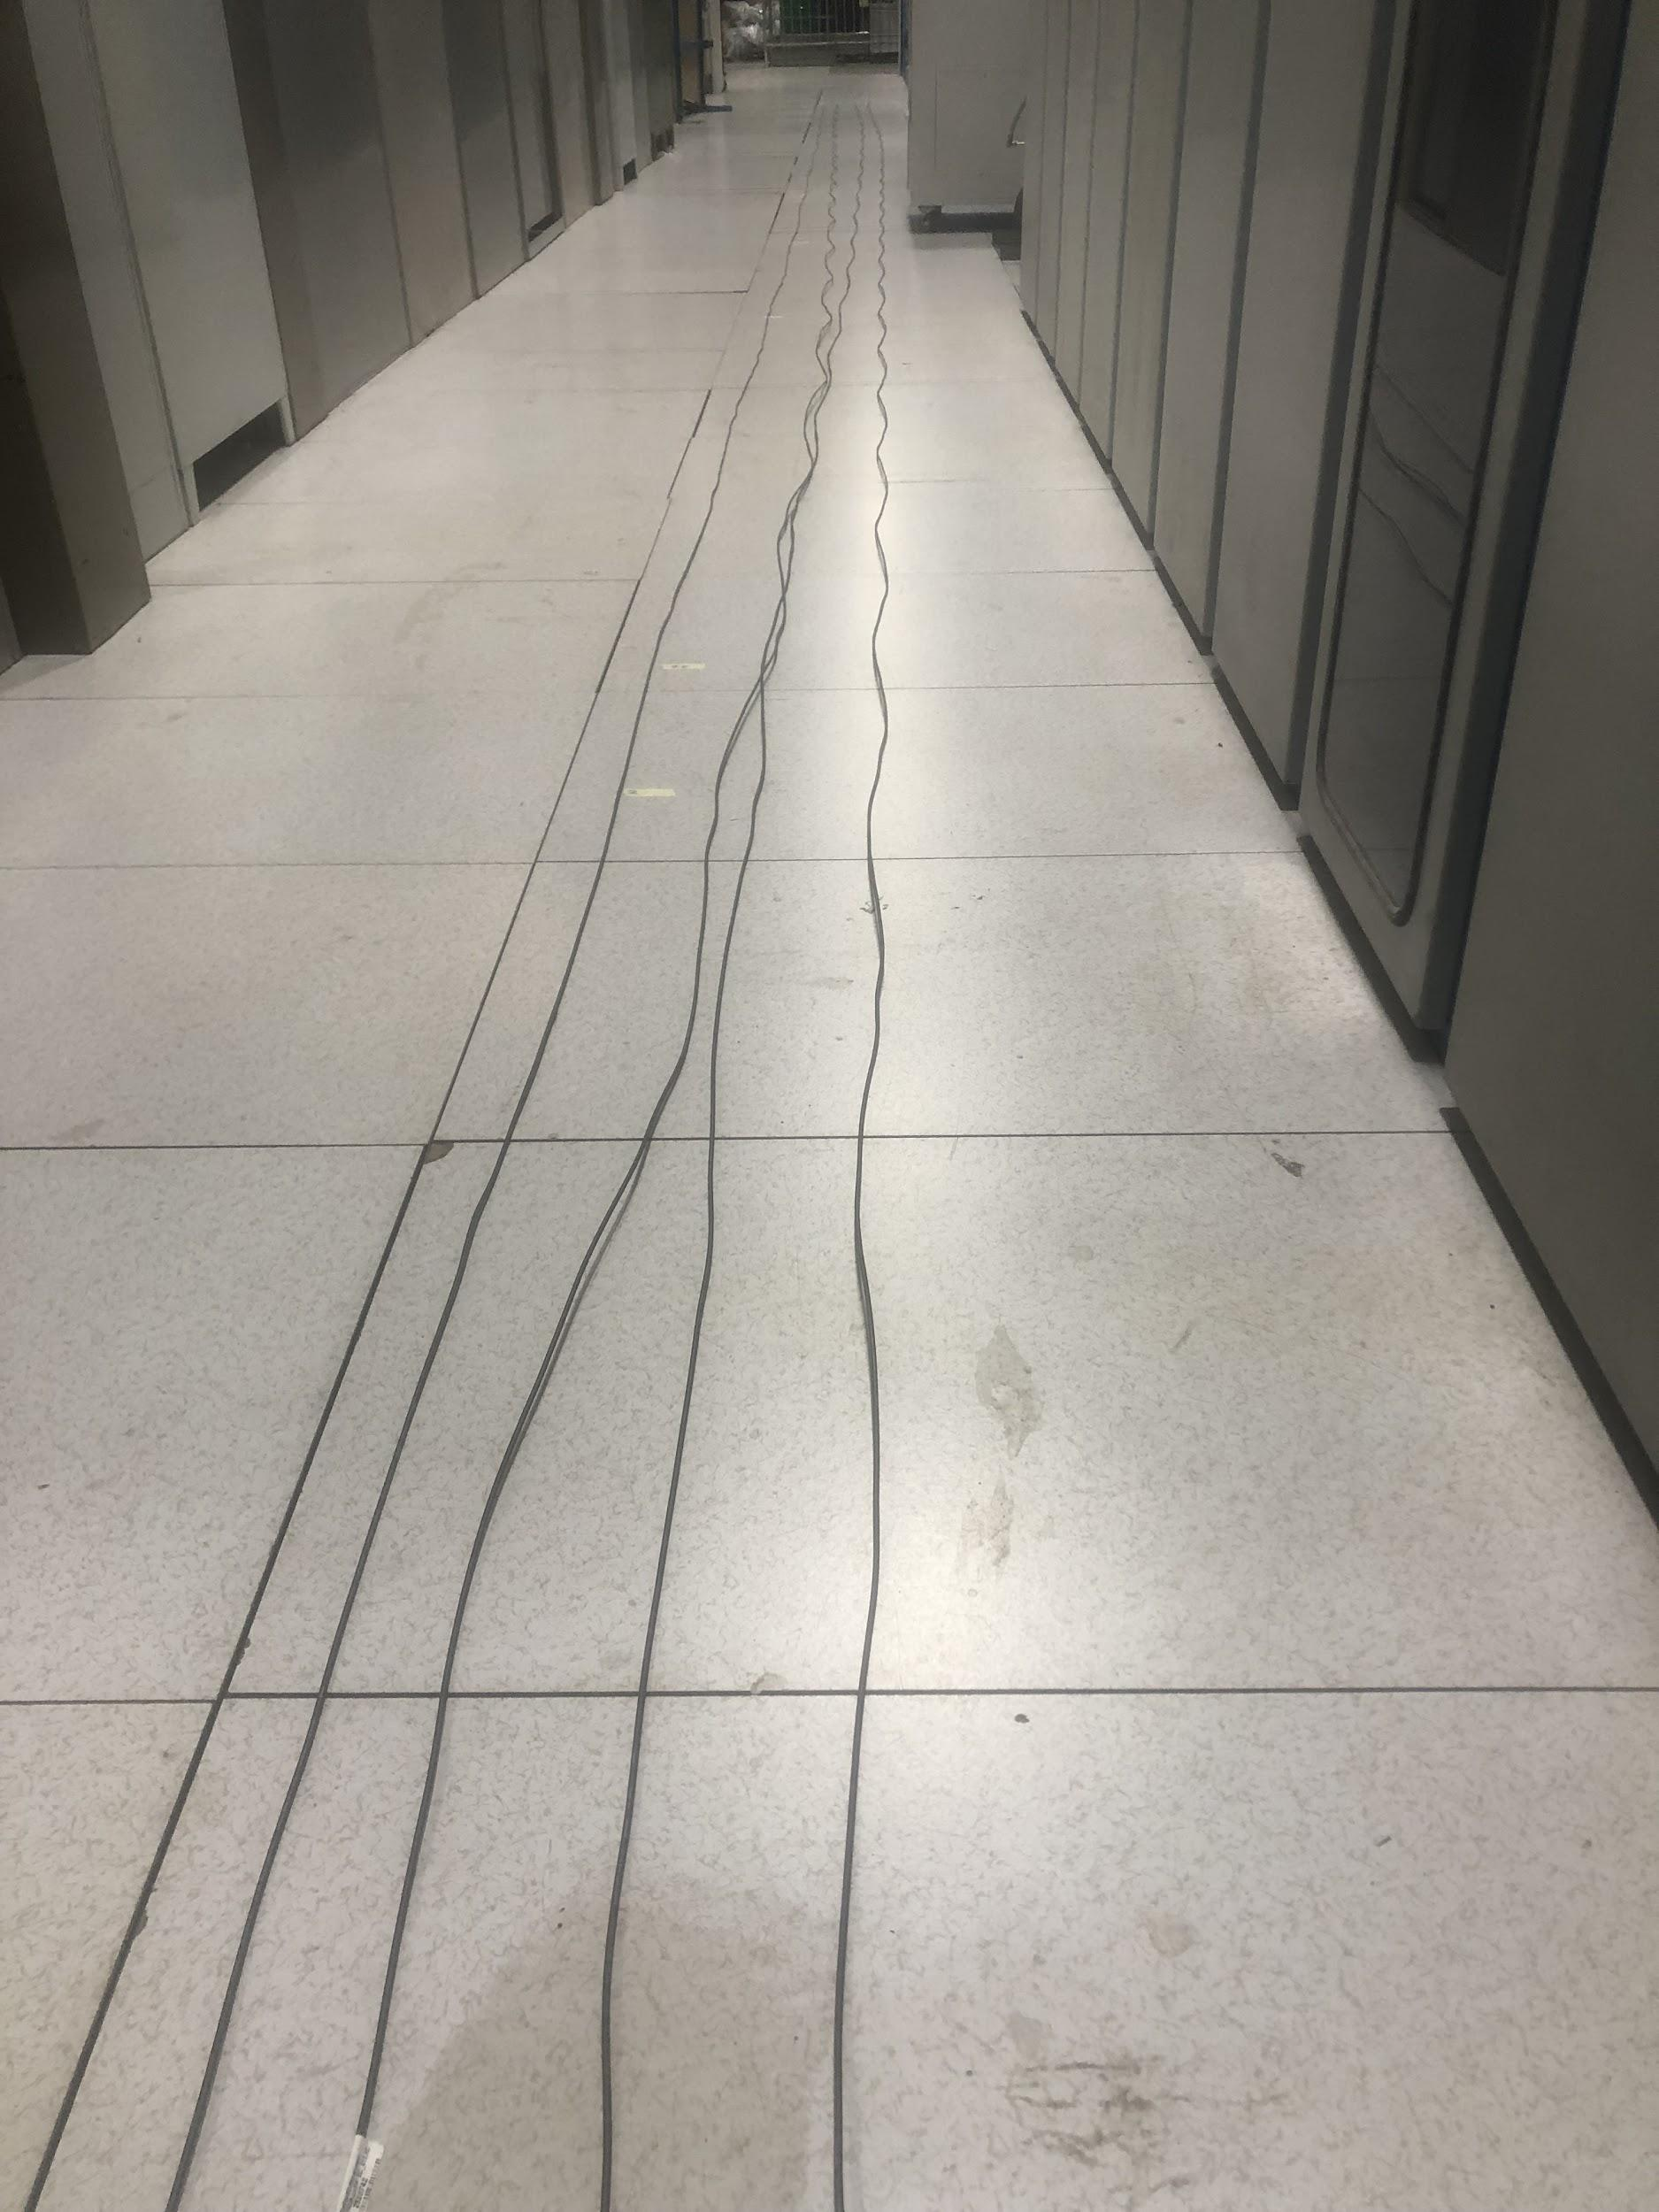
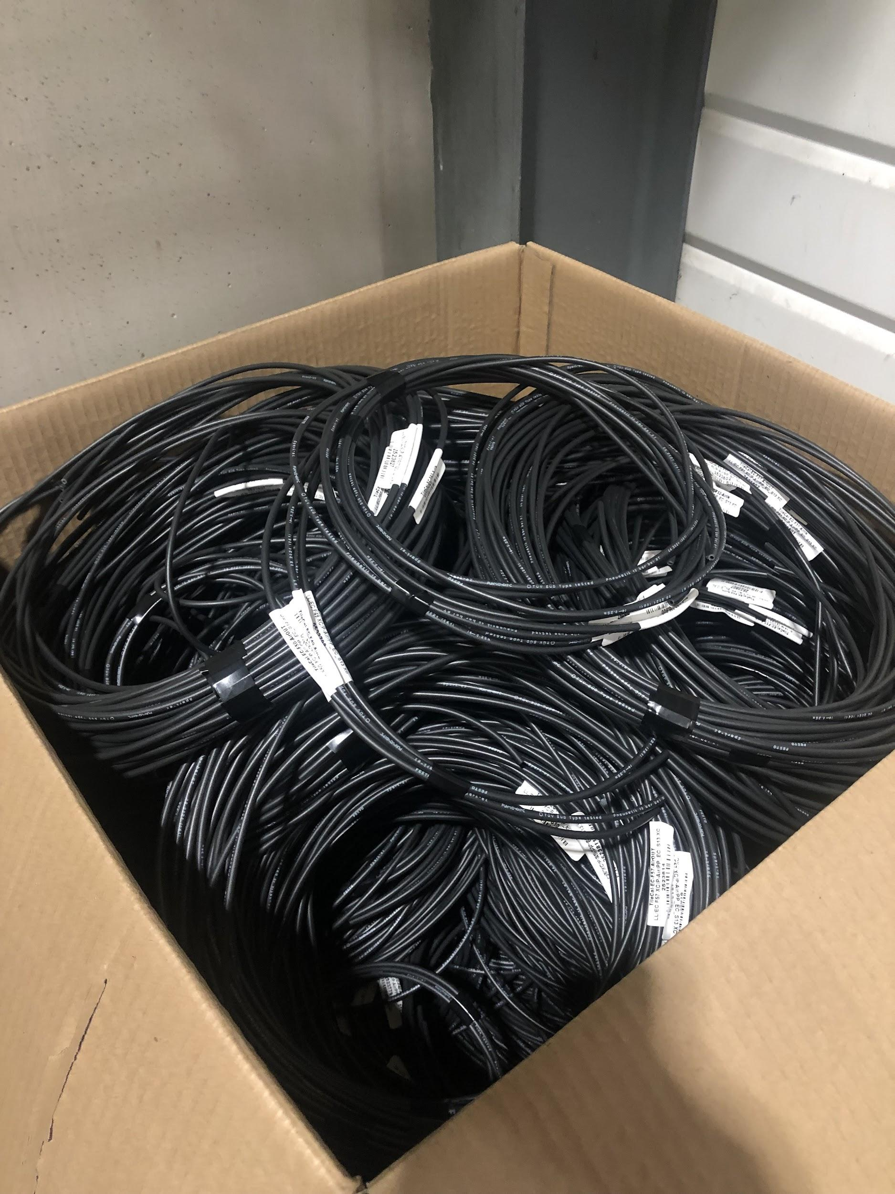
Air Hoses Preparation
We measured out all the hoses to be installed on EBC (as well as a decent number of those on EBA)
They were all labeled and bundled

Slide 35
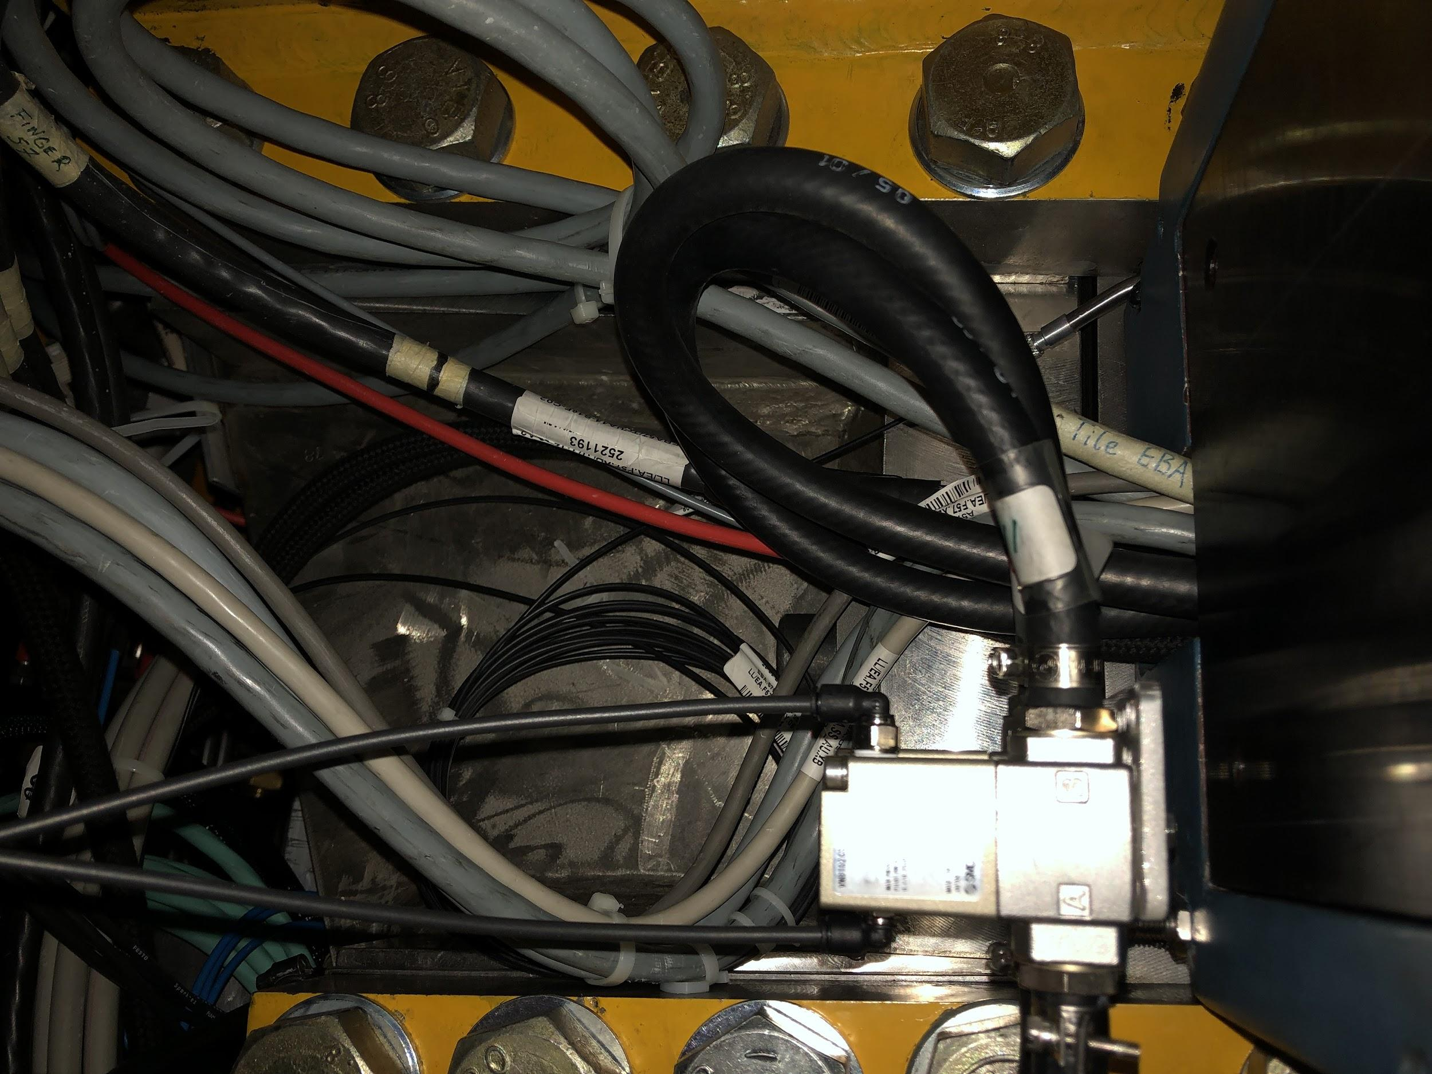
Connecting air hoses
Hoses were run around the outside of the detector to the patch panel by another team
We went around and plugged each one into the appropriate valve on EBA and EBC (LB already done)

Slide 36
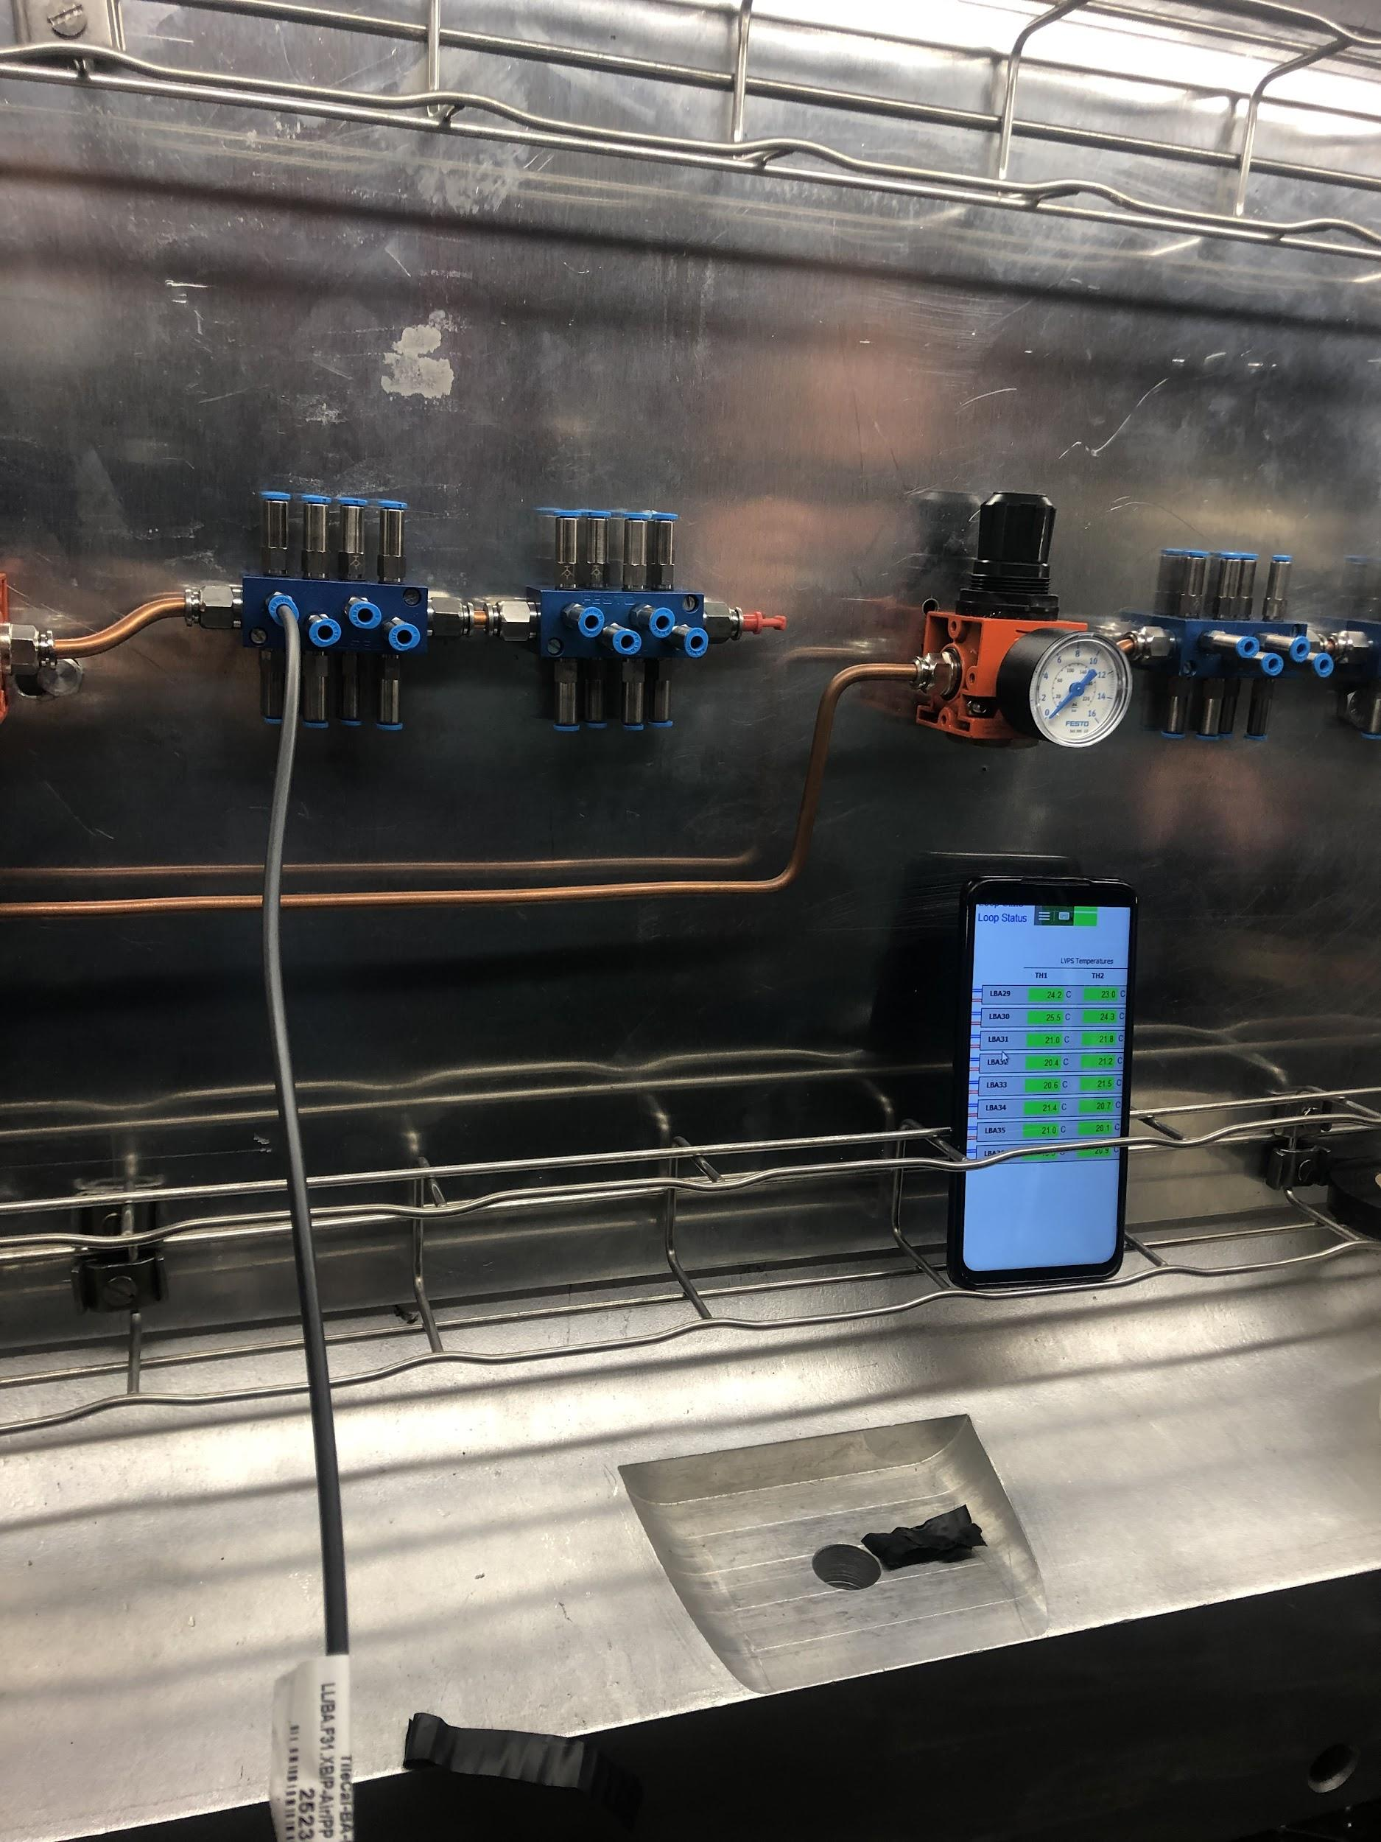
Commissioning
Hoses are gathered near a patch panel where they can be connected to a pressurized system
We check the in and out hoses for each module separately, and confirm they both increase the module’s temperature using DCS monitoring
Did on both EB and LB

Slide 37
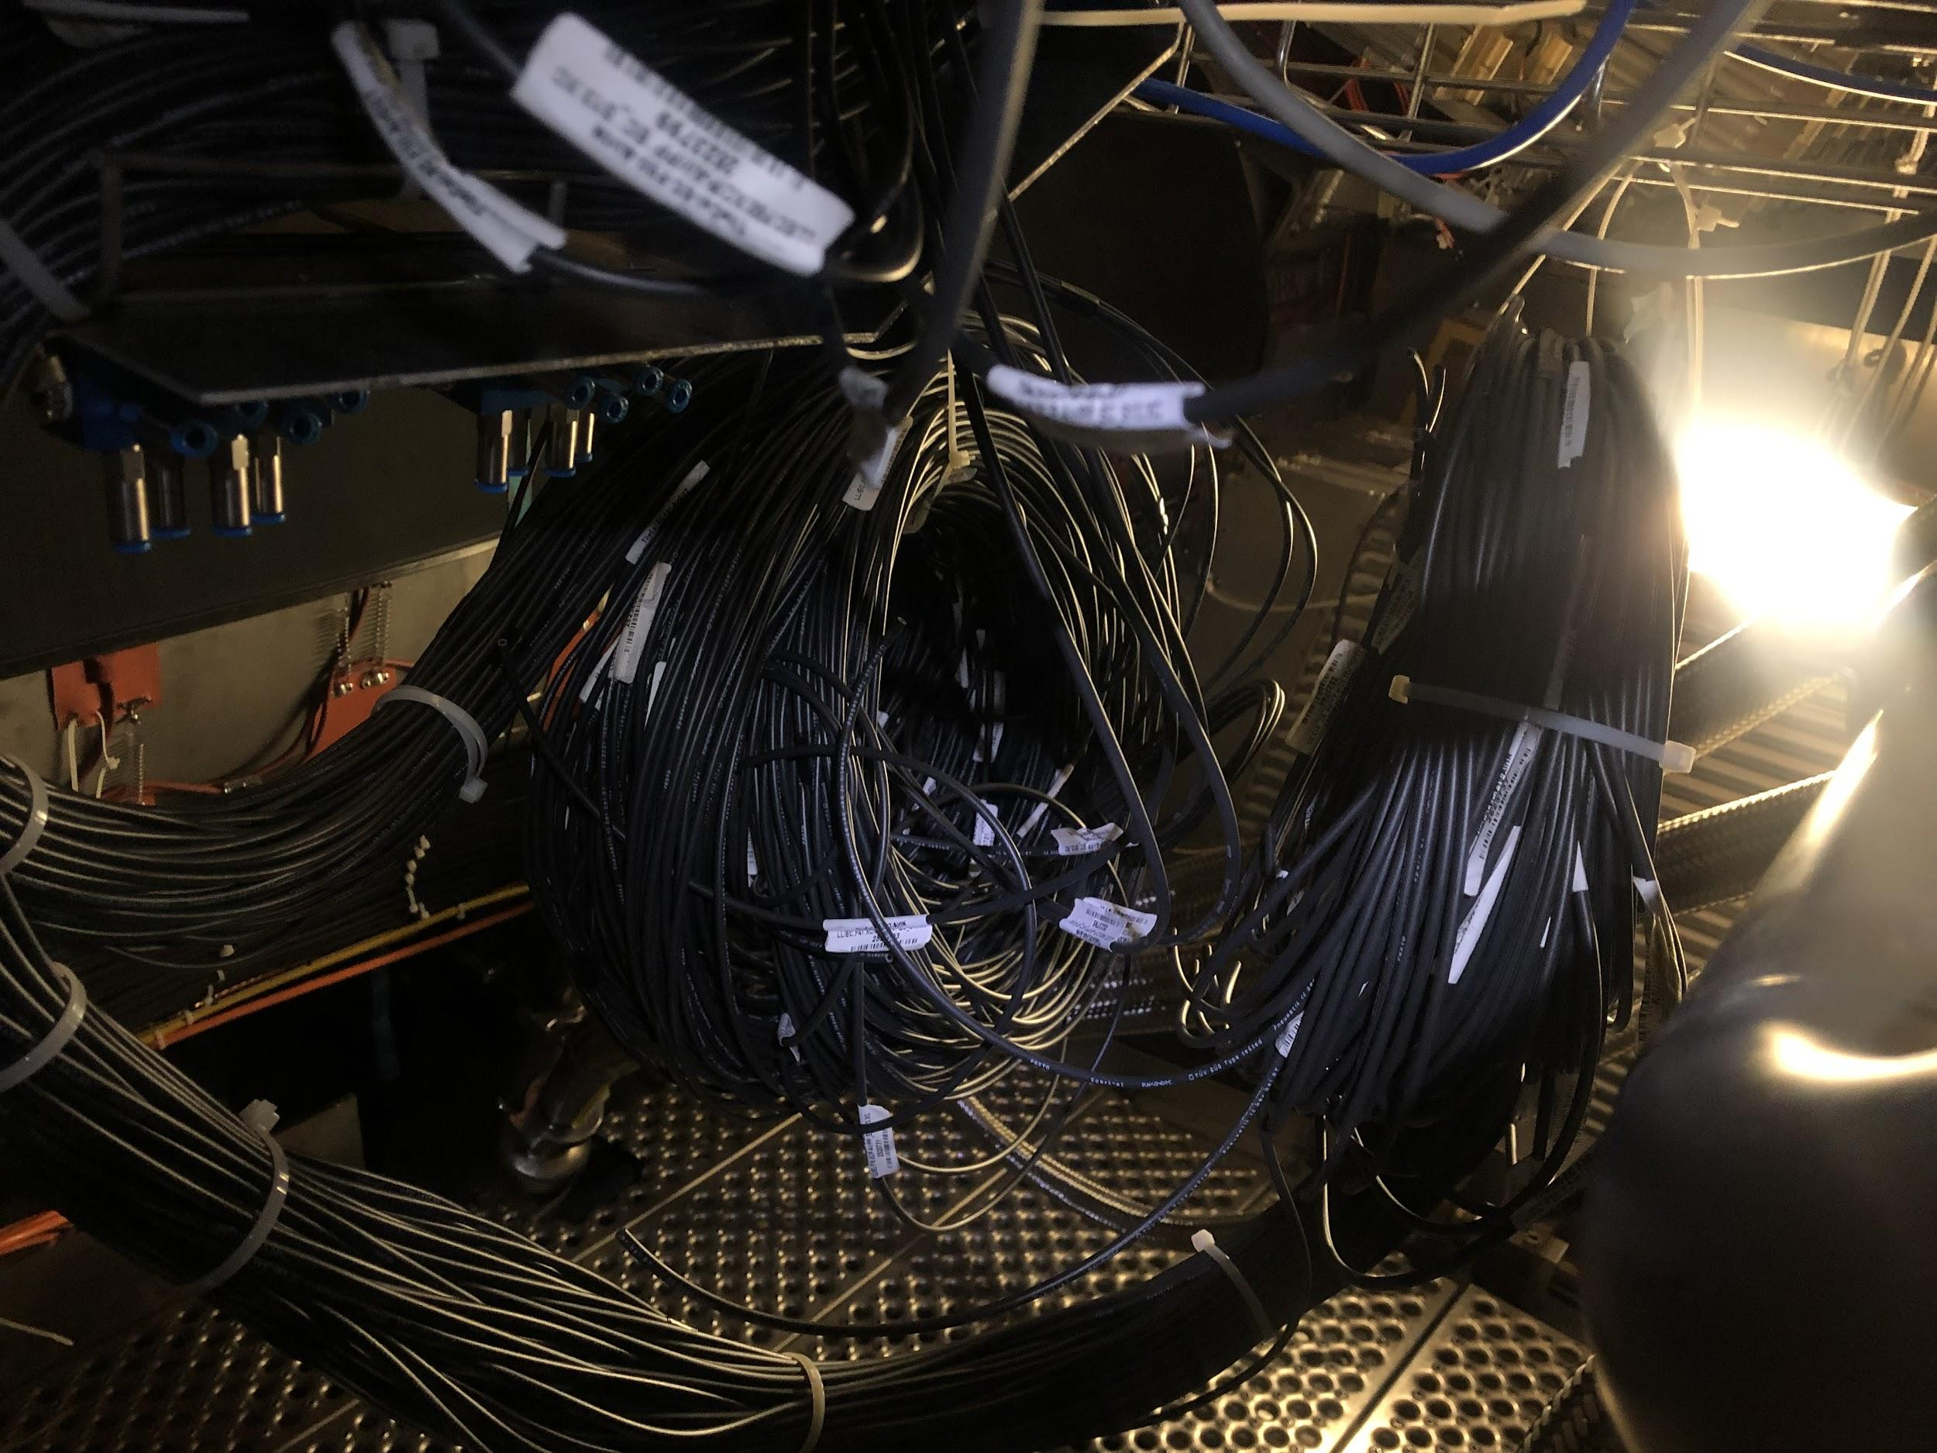
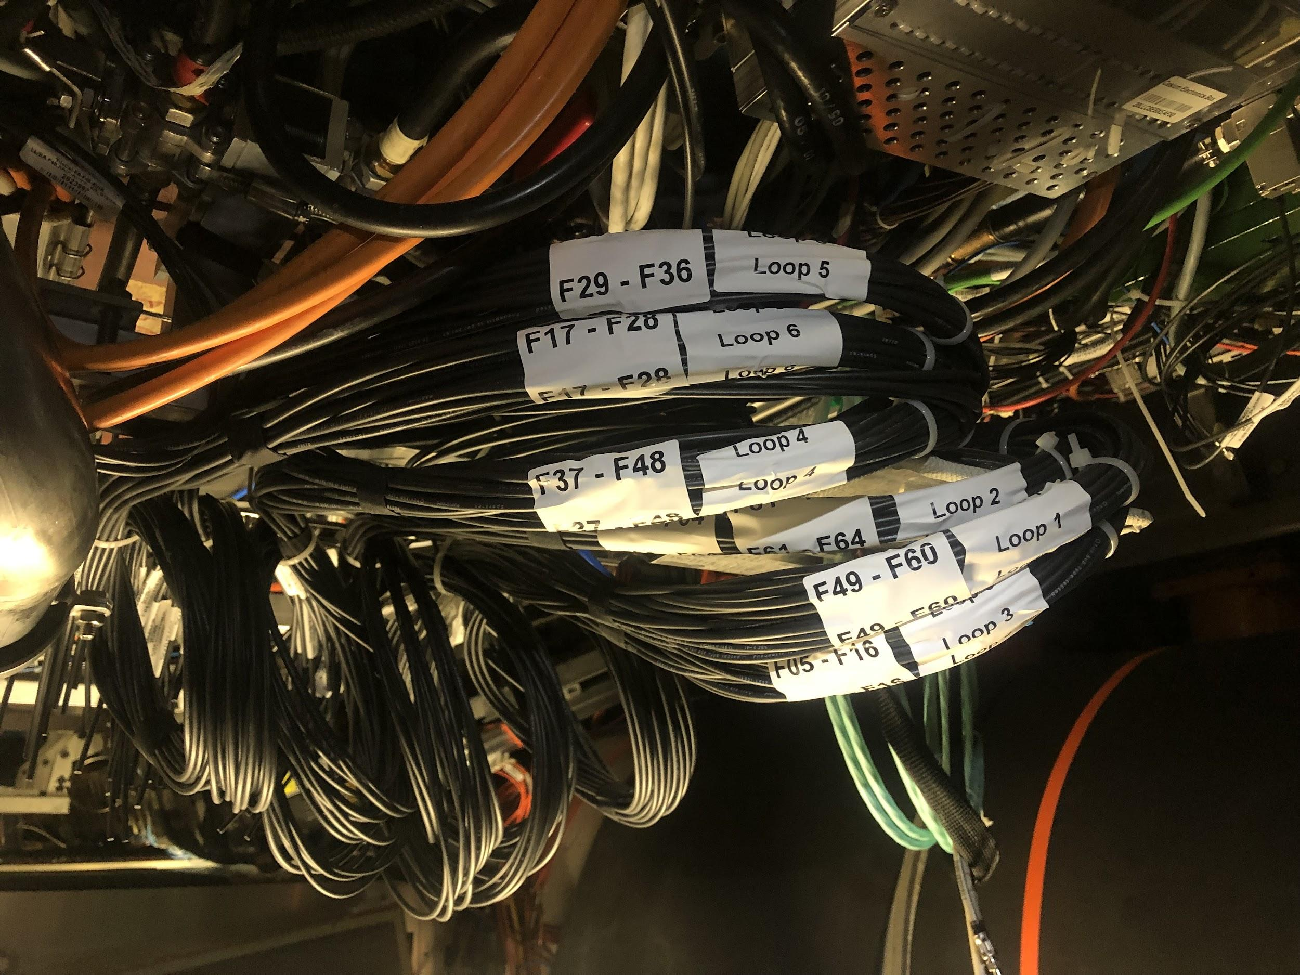
Final Touches
All measurements given for the hoses on EBA and EBC seemed to be about 1-2 m too long once run around the detector, so we trimmed and relabeled them all.

Slide 38
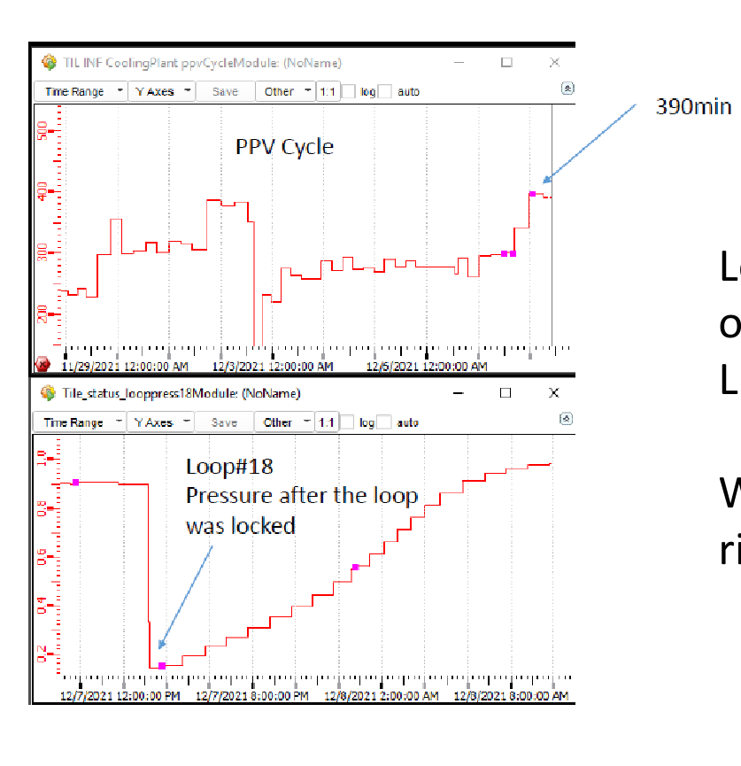
Identifying Leaks
Check PPV cycle
How often cooling system must be pumped down to a lower pressure
Now we can use the air hoses to shut off valves we suspect have leaks, then check PPV cycle to see if it improves

Slide 39
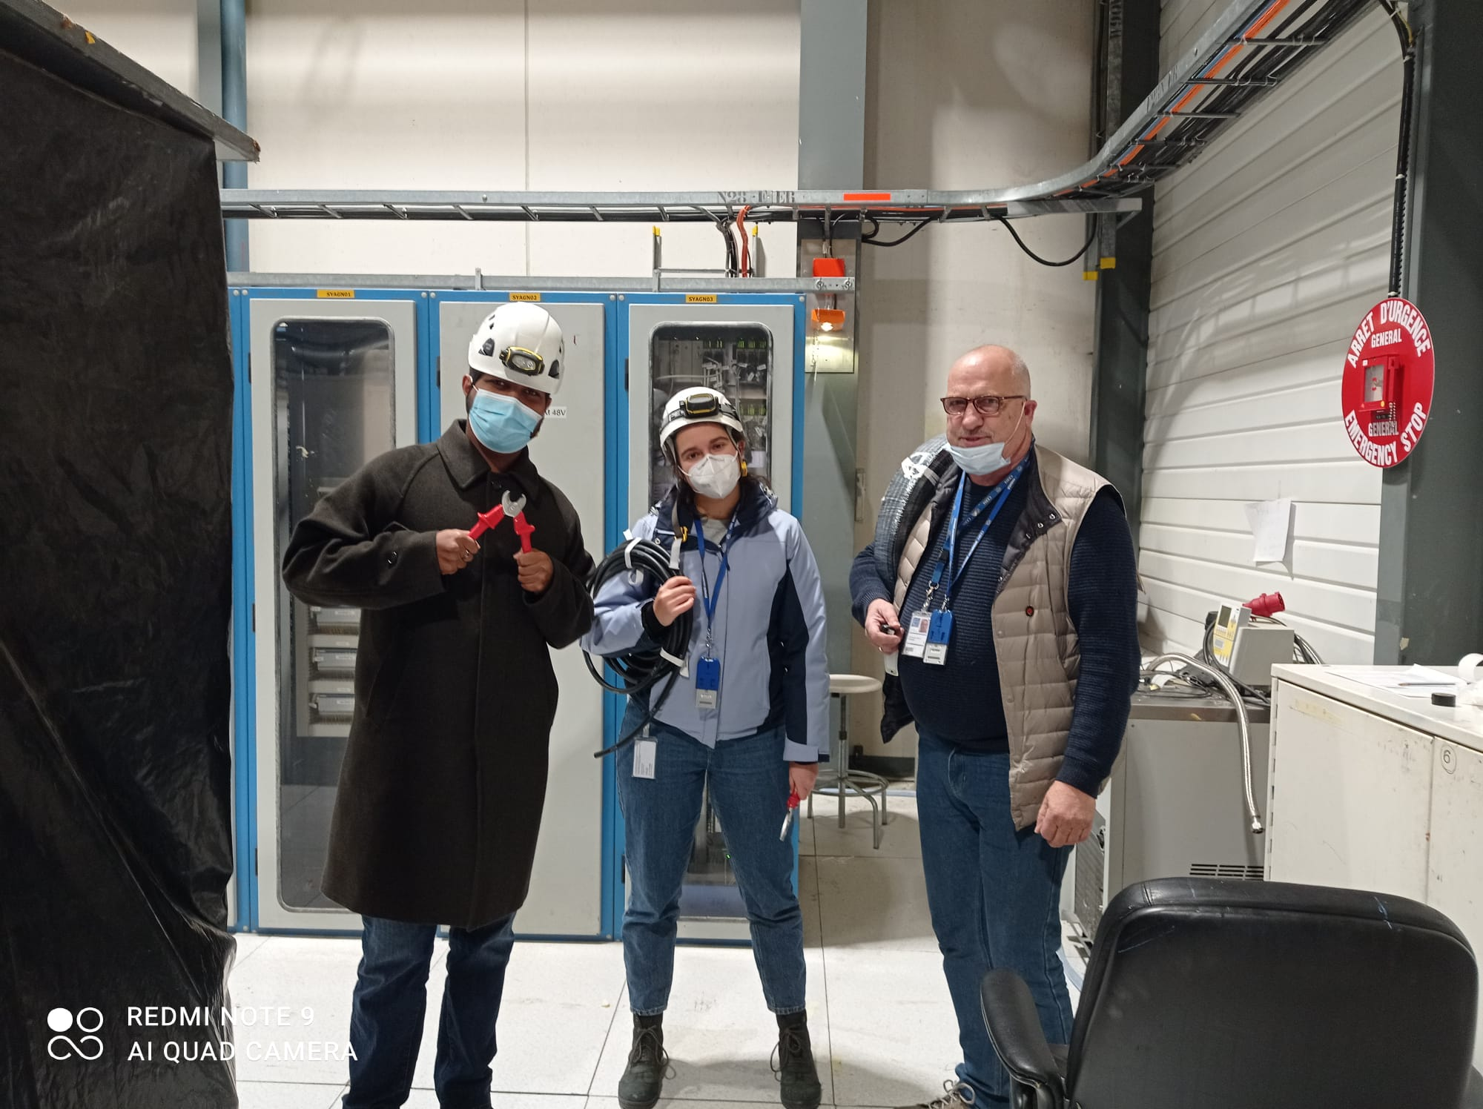
Current Status
All 4 partitions have valves on every module! They are all connected to air hoses and have been commissioned.
There are about 20 extra valves if any need to be replaced in the future.

Slide 40
LAr Simulation Work

Slide 41
Energy Correction due to Accordion Structure
Goal: To obtain a statistical model of energy modulation as a function of phi arising from accordion structure of LAr Calorimeter.
Final product: A functional form (TGraph) for the energy modulation in each EM layer of LAr Calo
Strategy: Use muon events generated at the center of detector to sample layer-energy dependency on phi
Fit these sample points to obtain a TGraph for each EM layer of LAr Calo
We will use these models to implement energy correction in FastCaloSim code.

Slide 42
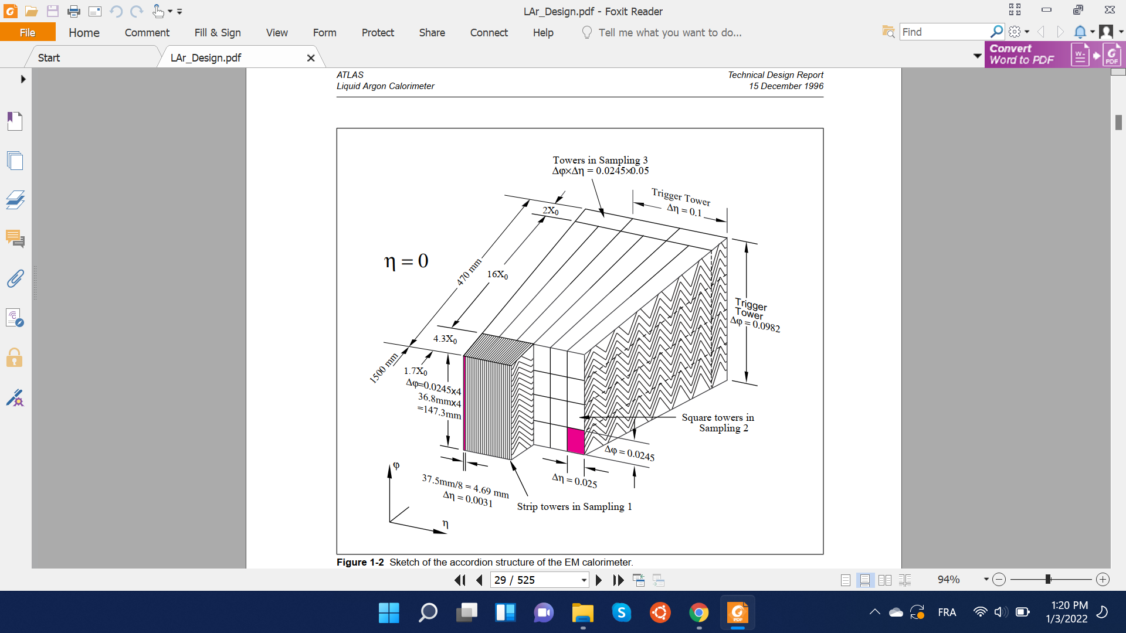
Accordion Structure & FastCaloSim
FastCaloSim is a framework that provides fast simulation of particle energy response of ATLAS detector.
Key simplification for fast simulation in LAr EM layers: idealize accordion wiggles by prismatic cells in 3D space
Run physics on idealized detector geometry
Correct for accordion effect on energy deposition at the end
To implement correction, we need to understand the phi dependence of energy deposition arising from the accordion structure.

Slide 43
Input Statistics
Muons (|Pdg = 13|) generated at the center of detector with
CME of 100 Gev
0 < phi < 2𝝅 & |eta| < 3
Eta range chosen to cover all of EM layers
Advantages of Muons: Heavier mass means more localized energy depositions (compared to electrons or photons). This gives us better phi precision during our scan.
Disadvantage of Muons: Heavier mass means muons deposit on average only 3-4 Gev with minimal ionization. This, in-turn, increases our energy uncertainty, requiring larger size of input data.
Muon event selection: We are only interested in Muon events that mainly deposit energy through MIPs. Other forms of deposition, for example, photon-radiation contribute to uncertainty in energy deposited at a particular phi value.
Therefore, we only keep muons with high enough final energies (E > 92 Gev).

Slide 44
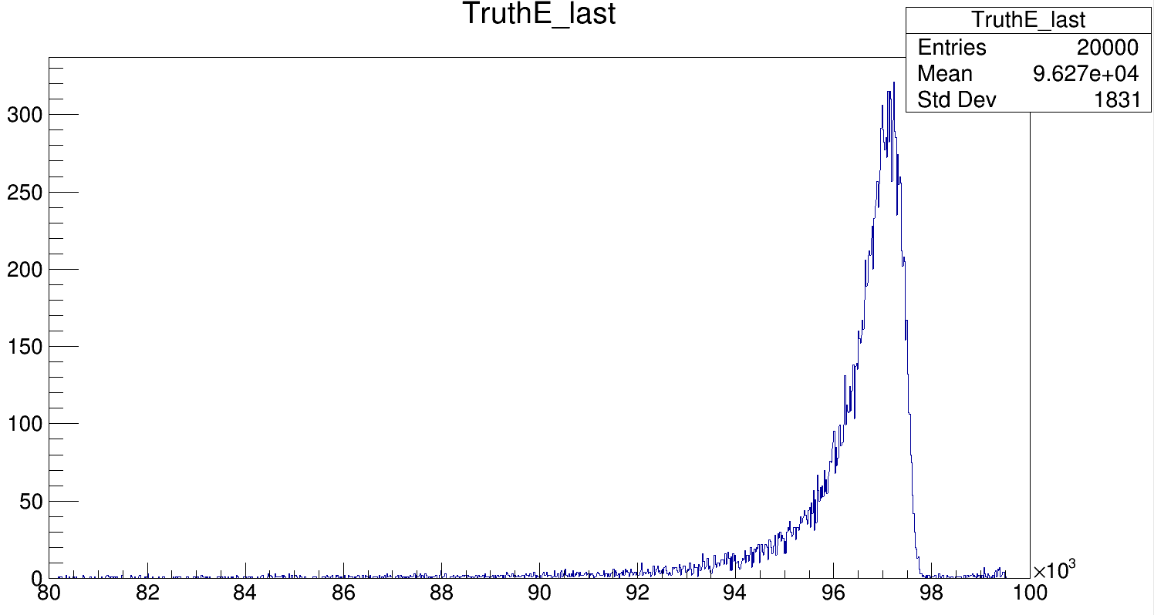
Final Truth-E of Muons
Selected events
Region of large non-MIP energy deposition
E (Mev)

Slide 45
Computing Energy Correction
The sample points (Ideal_phi, layer_energy) to be fitted are produced from our input data as follows:
for each EM layer in LAr Calo:
obtain total energy deposited by muon in layer (layer_energy)
obtain phi offset between full geometry and FastCaloSim (ideal) geometry
obtain muon truth eta/phi as: phi = newTTC_mid_phi[0][layer]
get impactCell of muon in layer (code courtesy of Michele)
compute phi offset as: phi_correction = impactCell_phi - impactCell_phi_raw
translate phi value from full geometry to ideal geometry accounting for periodicity
ideal_phi = (|phi - phi_correction|) mod (𝜋/512.)

Slide 46
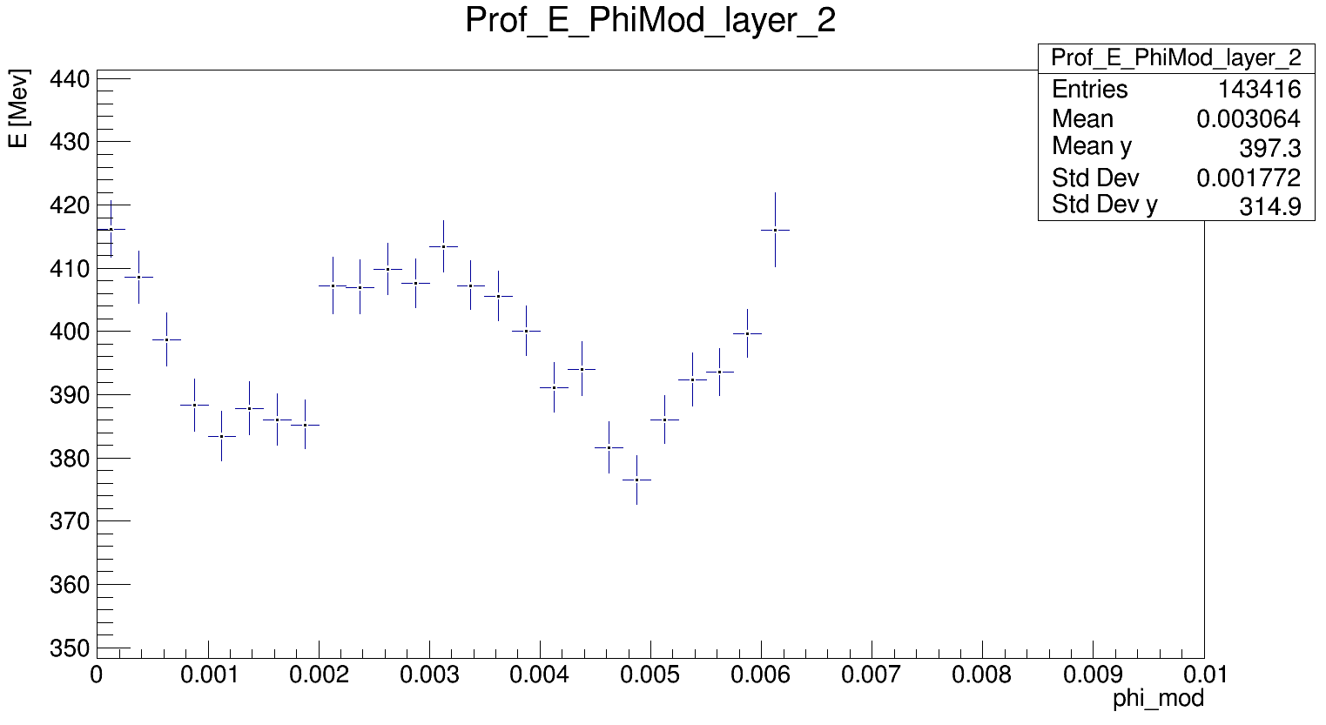
Result
Result for Layer 2 of LAr EM layers. Most important for this work as it is the layer with the most phi partitions.
Result shows, as expected, phi periodicity of energy deposition.
The final-energy cut, eliminating non-MIP energy deposition, significantly improved our energy uncertainty
Currently at about 2-3% for initial data size of 150k events.

Slide 47
Remaining Work
Submit data request for large input data
Still need to understand what the LAr-Sim team considers to be an acceptable error range which determines the size of the input data required
If input data size is too big, my code will be quite slow.
Might need to re-organize code to make it suitable for condor submission for fast execution
Once we have enough statistics, fit a curve to our points to obtain the functional dependency: E(phi)
Implement the energy correction in the FastCaloSim code to account for accordion structure

Slide 48
Pictures:)

Slide 49

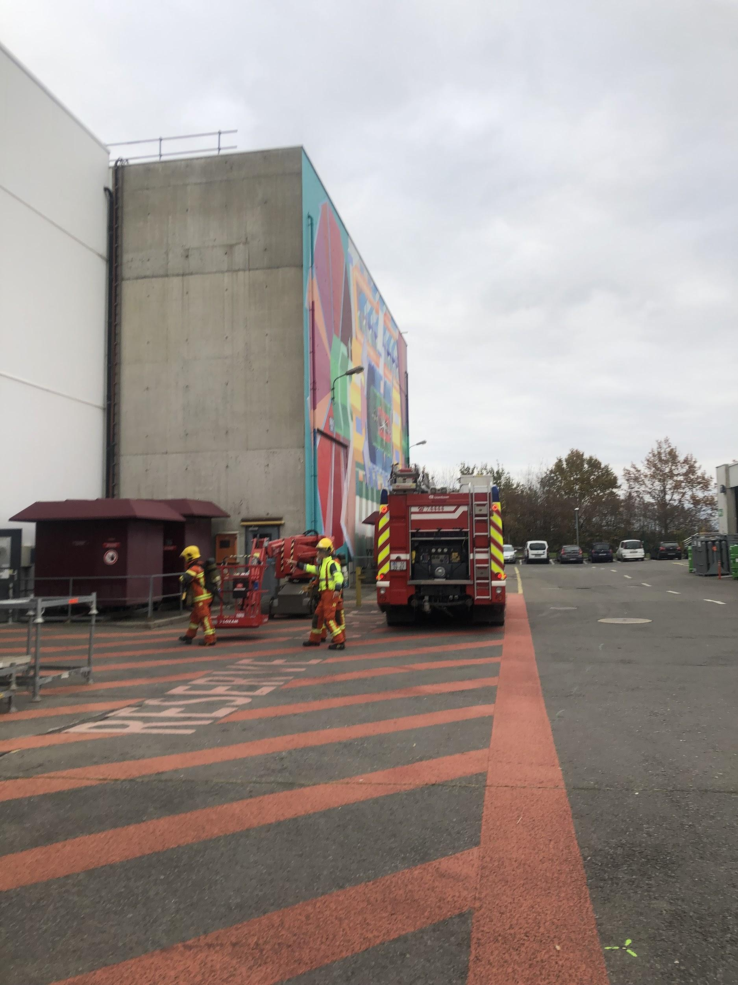

The CIS techs go to Barcelona!
When we had to evacuate the detector :)

Slide 50



Slide 51
Thank You!

